Slide 1
EURO MANGANESE INC. QUARTERLY INVESTOR CALL

Slide 2
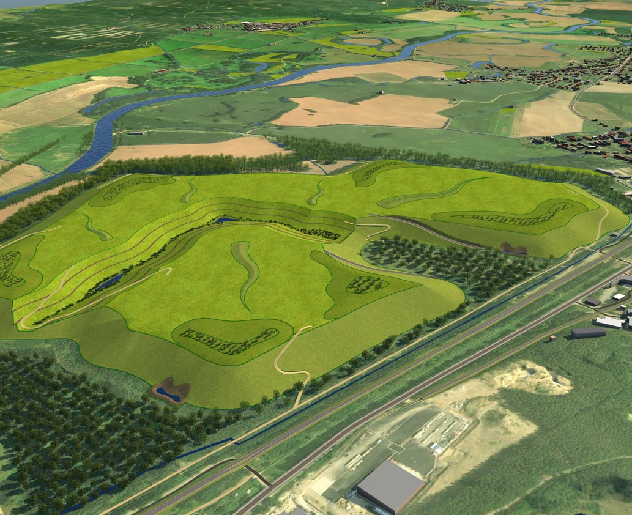

THE CHVALETICE
MANGANESE PROJECT
Recycling Yesterday’s Waste To Support Europe’s
E-mobility Future
CORPORATE PRESENTATION
February, 2022

Slide 3
Disclaimer
Forward-Looking Statements and Risks Notice
Except for statements of historical fact relating to Euro Manganese Inc. (“EMN” or the “Company”), certain information contained in this presentation constitutes forward-looking statements. When we discuss our costs and timing of current and proposed evaluation; planning; development; capital expenditures; cash flow; working capital requirements; and the requirement for additional capital; operations; revenue; margins and earnings; future prices of electrolytic manganese metal, manganese sulphate and other products; future foreign currency exchange rates; future accounting changes; future prices for marketable securities; future resolution of contingent liabilities; or other things that have not yet happened in this review, we are making statements considered to be forward-looking information or forward-looking statements under Canadian law. We refer to them in this review as forward-looking information.
The forward-looking information typically includes words and phrases about the future, such as: plan, expect, forecast, intend, anticipate, estimate, budget, scheduled, believe, may, could, would, should, might, and will. We can give no assurance that the forward-looking information will prove to be accurate. It is based on a number of assumptions management believes to be reasonable, including but not limited to the continued operation of the Company’s exploration, evaluation and development activities, no material adverse change in the market price of commodities and exchange rates, and such other assumptions and factors as set out herein.
It is also subject to risks associated with our business, including but not limited to: risks inherent in the mineral exploration and evaluation and mineral extraction business; commodity price fluctuations; competition for mineral properties; mineral resources and reserves and recovery estimates; currency fluctuations; interest rate risk; financing risk; environmental risk; foreign activities; legal proceedings; and other risks.
If our assumptions prove to be incorrect or risks materialize, our actual results and events may vary materially and adversely from what we currently expect as set out in this review.
Forward-looking information is designed to help you understand management’s current views of our near and longer-term prospects, and it is not appropriate for other purposes. We will not necessarily update this information unless we are required to by law.

Slide 4
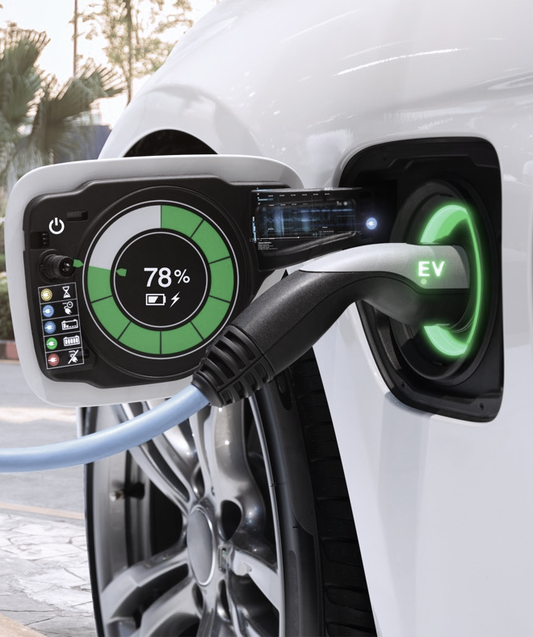








Secure, sustainable, high purity manganese
Only primary manganese resource in Europe
Aim to have best-in-class environmental performance
In the heart of the world’s fastest growing EV battery market
Excellent local community relationships
Project supported by EU institutional investments
Definitive feasibility study nearing completion
Strong cash position
Experienced team with deep high-purity manganese expertise

Slide 5
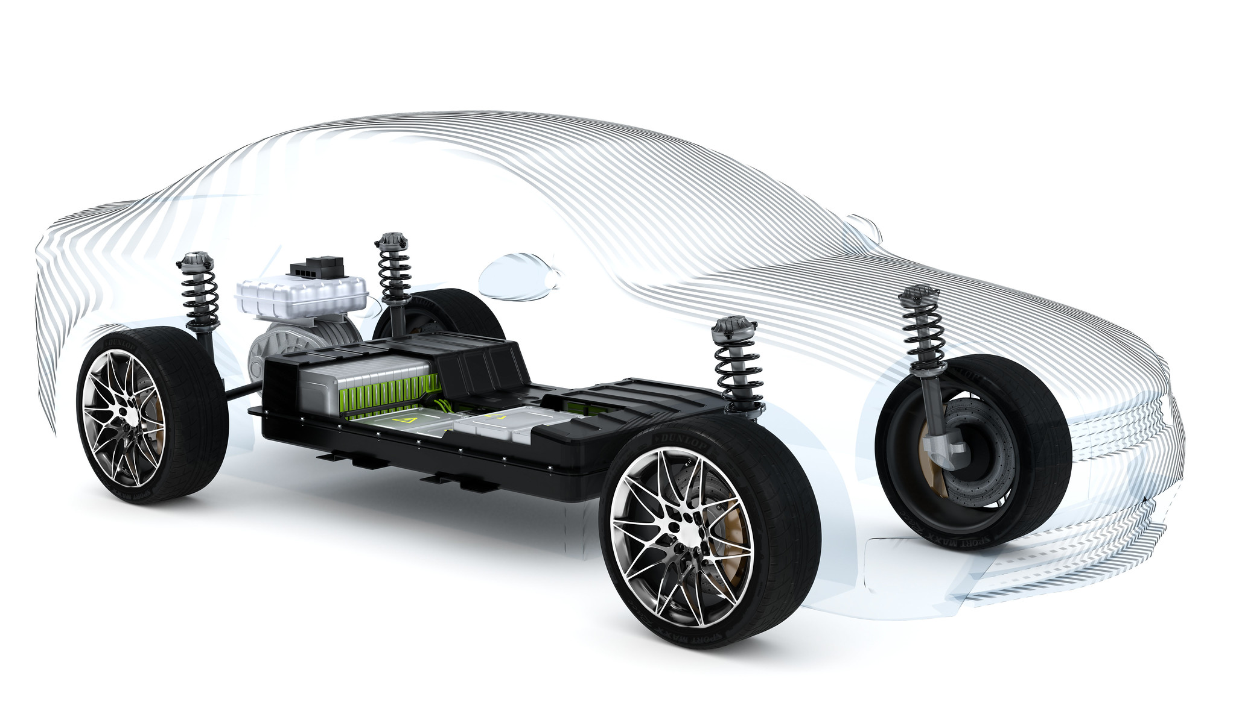

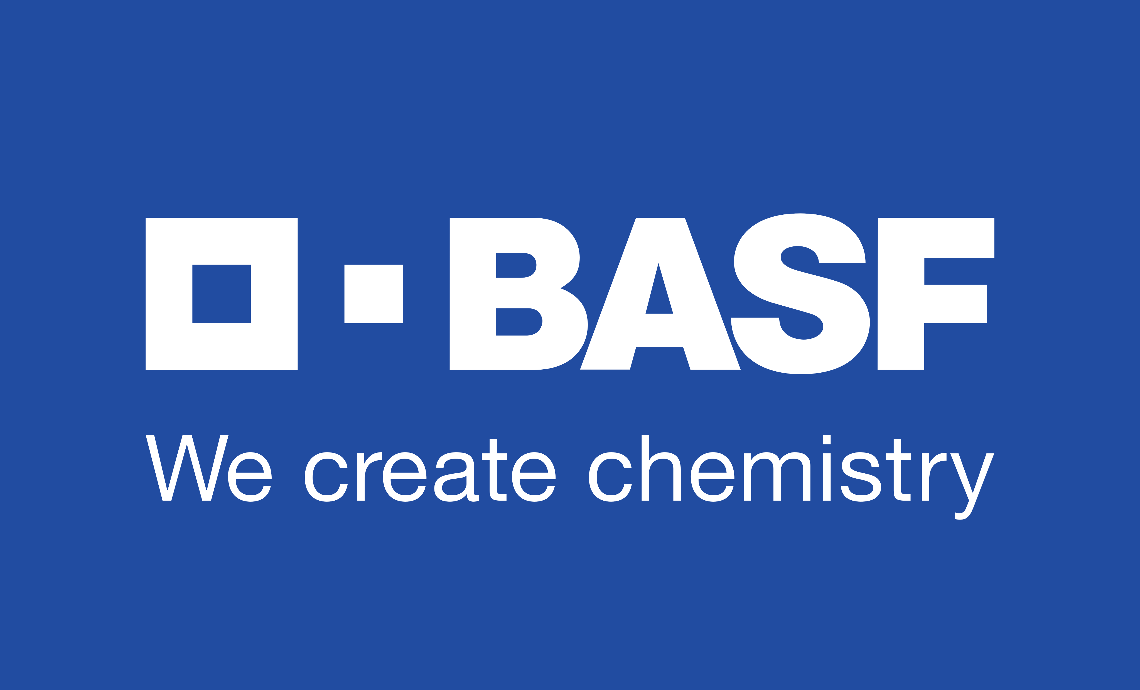








Industry players have committed to increasing manganese in battery chemistries
MARKET OVERVIEW
All major EV, battery cell and cathode active material producers have numerous manganese-based chemistries in production or under further development

Slide 6
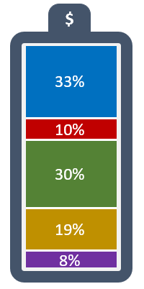
Lower cost EV battery chemistries to drive high purity manganese content per KWh
MARKET OVERVIEW
HP Manganese, like cobalt, stabilises nickel in a modern Li-ion EV battery, yet it accounts for only 1-2% of the cost of cathode materials
HP Manganese requirement by battery chemistry *
Increasing HP Manganese requirement 2020 to 2030, average in EU*
Kg per KWh
Kg per KWh
Lower cost battery chemistries
+80%
kg
$
Mn
17%
7%
Cathode Cost
Li
11%
33%
NMC-622
(Illustrative)
Ni
54%
59%
Co
18%
NMC-811
NMC-622
NMC-532
NMC-111
NMC-370
LNMO
2020
2030
Nickel-manganese-cobalt (NMC) cathode batteries are currently the dominant chemistry,
with ~ 50% market share (2020)
High-purity manganese demand will increase as OEMs commit to
high Mn chemistries
Recycling of older batteries will result
in a deficit of manganese
Sources: Cairn ERA, Industry sources, Bloomberg, CPM
*) NMC & LNMO chemistries only

Slide 7
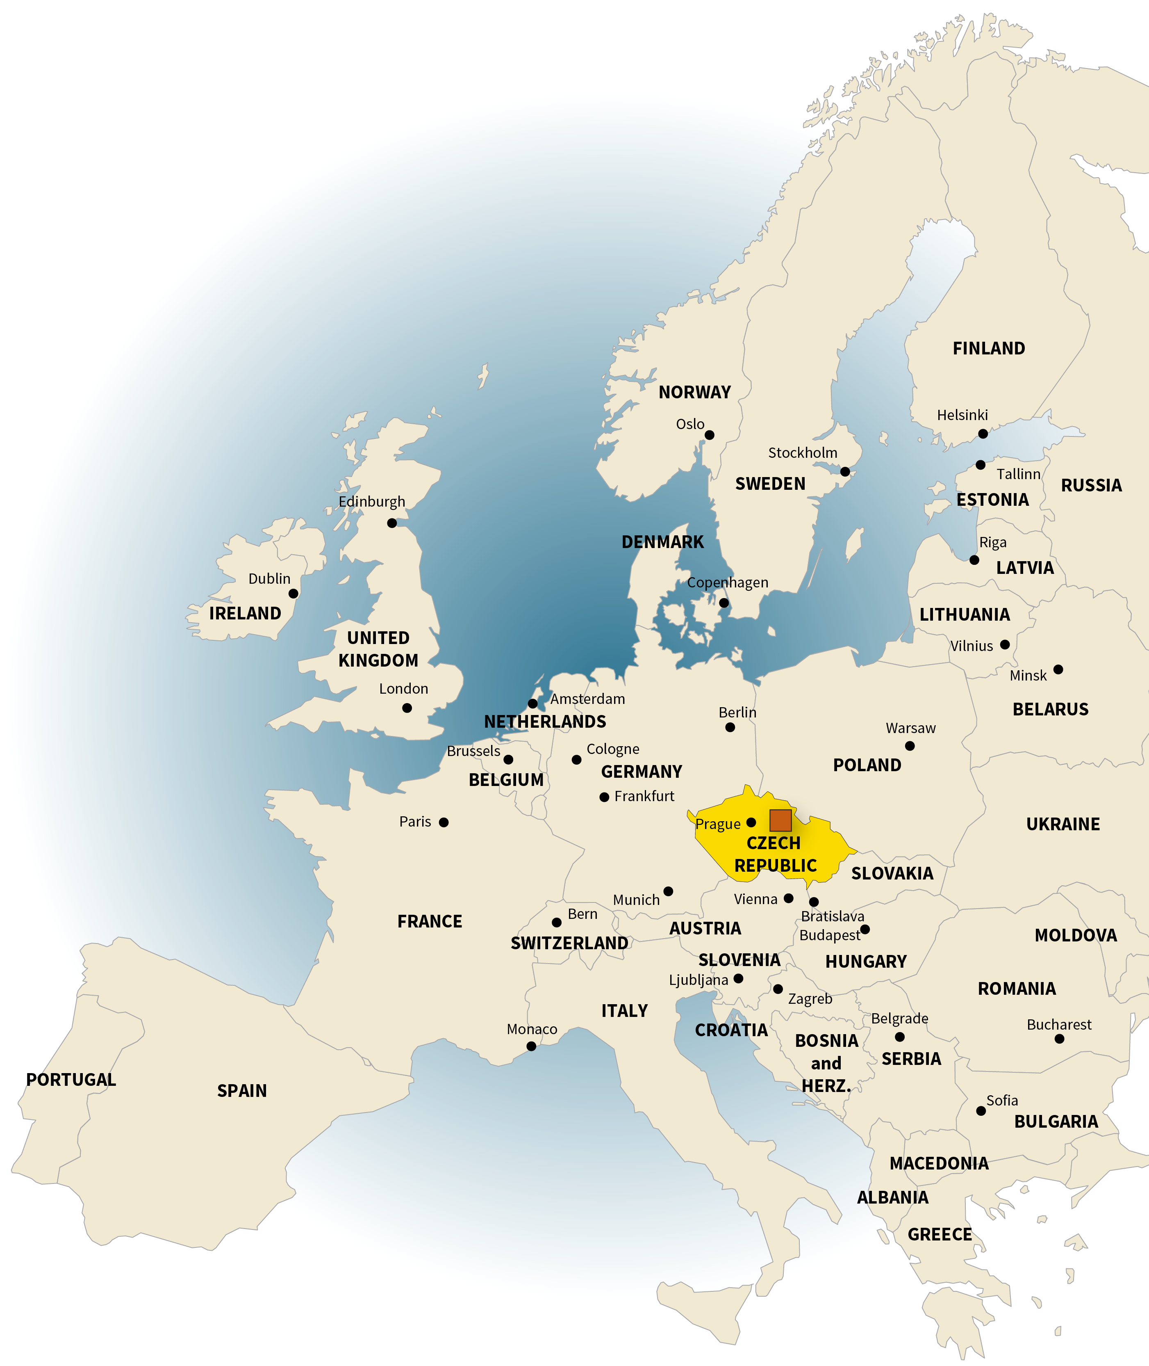

High purity manganese demand to accelerate as EU EV battery market increases
MARKET OVERVIEW
Europe’s global hub for EV with 1,400+ GWh planned battery capacity by 2030
(56 cell factories)
Europe’s Battery Factories 2030
EU: Fastest growing high-purity manganese market in the world
1400 GWh
EU market in ktpy HP Mn
announced so far
Precursors & Cathodes
+2780%
Battery Cells
75%
Battery Parts
(Separator, Electrolyte)
are likely to be built
Battery Packs
65%
Electric Car Factory
likely capacity utilization rate
60%
of batteries produced will use Mn
Global market in ktpy HP Mn
0.680 kg/kWh
+1138%
average consumption
of HP Mn by these batteries
278,000 mt
of HP Mn per year will be needed
Sources: Cairn Energy Research Advisors and CPM Group

Slide 8


Customers and regulators committing to sustainable, local supply…
MARKET OVERVIEW
OEM, battery & cathode-makers
BASF: “We in BASF have always believed in having the supply of key raw materials in close customer proximity. We believe that local production and local content for battery materials are key to ensure a resilient and sustainable supply chain.”
Volkswagen/Bosch: “Setting out to establish a fully localized European supply chain for e-mobility made in Europe certainly marks a rare opportunity in business history.”
Stellantis: “The Company intends to maximize the full value of the battery life cycle through repair, remanufacturing, second-life use and recycling, as well as ensure a sustainable system that prioritizes customer needs and environmental concerns.”
Regulators
European Battery Alliance and European Raw Materials Alliance are stepping up activities to mobilize funding and streamline permitting procedures for battery raw materials projects
Establishment of green battery supply chain with mandatory green procurement, including responsible sourcing and minimum levels of recycled content.
EU’s “Fit for 55” legislative package is setting the stage for profound transformation
In the future, the EU will allow only the greenest batteries, made with the greenest raw materials, to be sold in Europe

Slide 9


…however, in Europe there is no ore supply and a lack of production capacity
MARKET OVERVIEW
Regional Primary Ore Supply
Regional High Purity Mn Production
EUROPE
No ore supply in Europe today
EMN primary supply (2026)
CHINA
Low grade ore
90% of Mn ore needed is imported (mainly from Africa)
AFRICA
Large ore resources
Ore exported to China
Small amount exported to Europe
Some processed in South Africa
EUROPE
There is a small European plant processing African ore (2ktpa)
Euro Manganese plans to be the third non-China plant (50ktpa at full capacity)
CHINA
2/3rds of high purity manganese
(60ktpa)
Lack of traceability
Variable specifications and purity
AFRICA
There is a plant in South Africa currently producing high purity manganese metal (28ktpa)
Source: CPM Group, based on 2020 data

Slide 10
Significant deficit of high purity manganese production facilities
MARKET OVERVIEW
Global High Purity Manganese Demand & Supply to 2030
(thousand tonnes of Mn)
High Purity Manganese Demand &
Local Supply in Europe to 2030
(thousand tonnes of Mn)
Europe could account for 25% of global HP Mn demand projected by 2030
Demand
EU Demand
433kt HP Mn deficit
Global production needs to increase more than 10-fold
10x
Supply
Other European Supply
EMN Supply
All rights reserved Cairn Energy Research Advisors and CPM Group ©2021

Slide 11



HP Manganese prices are starting to follow the critical metal trend
MARKET OVERVIEW
Battery Metal Prices Feb. 2018 – Feb. 2022
European HP manganese prices attract a premium to China prices
per metal unit, Index: Feb 2018 = 100
Manganese
EU Price Uplift
Premiums for:
EU sourcing
Green credentials
Traceability
Exceptional purity
Recycled content
Nickel
Lithium
Cobalt
Non-compliant suppliers may need to pay “EU border carbon tax”
China EXW
Transport
Premiums
European
Source: Bloomberg, CPM
Source: Freightos.com, CPM
Transport based on Feb 2022 transport quotes (20’ container Changsha to Berlin)

Slide 12
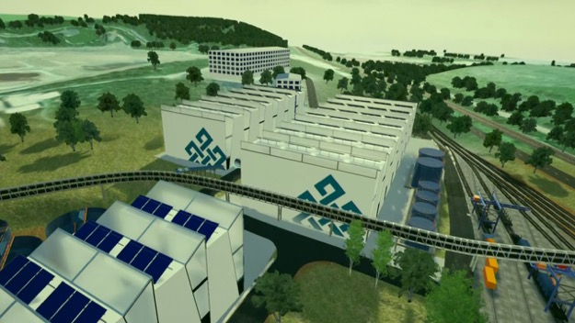




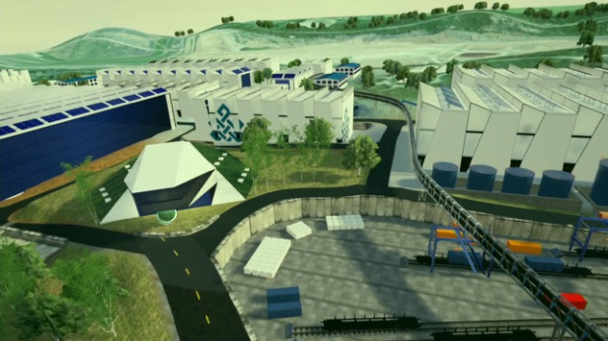


The Chvaletice Manganese Project
PROJECT OVERVIEW
Heart of Europe, Czech Republic
Access to modern, reliable infrastructure at site
Rehabilitation of historical mine tailings, which contain Mn resource
Resource and processing co-located
Excellent local support and community engagement
50Kt production per year for 25 years based on NI 43:101/JORC 2012
First step in building multi-asset high purity manganese platform

Slide 13
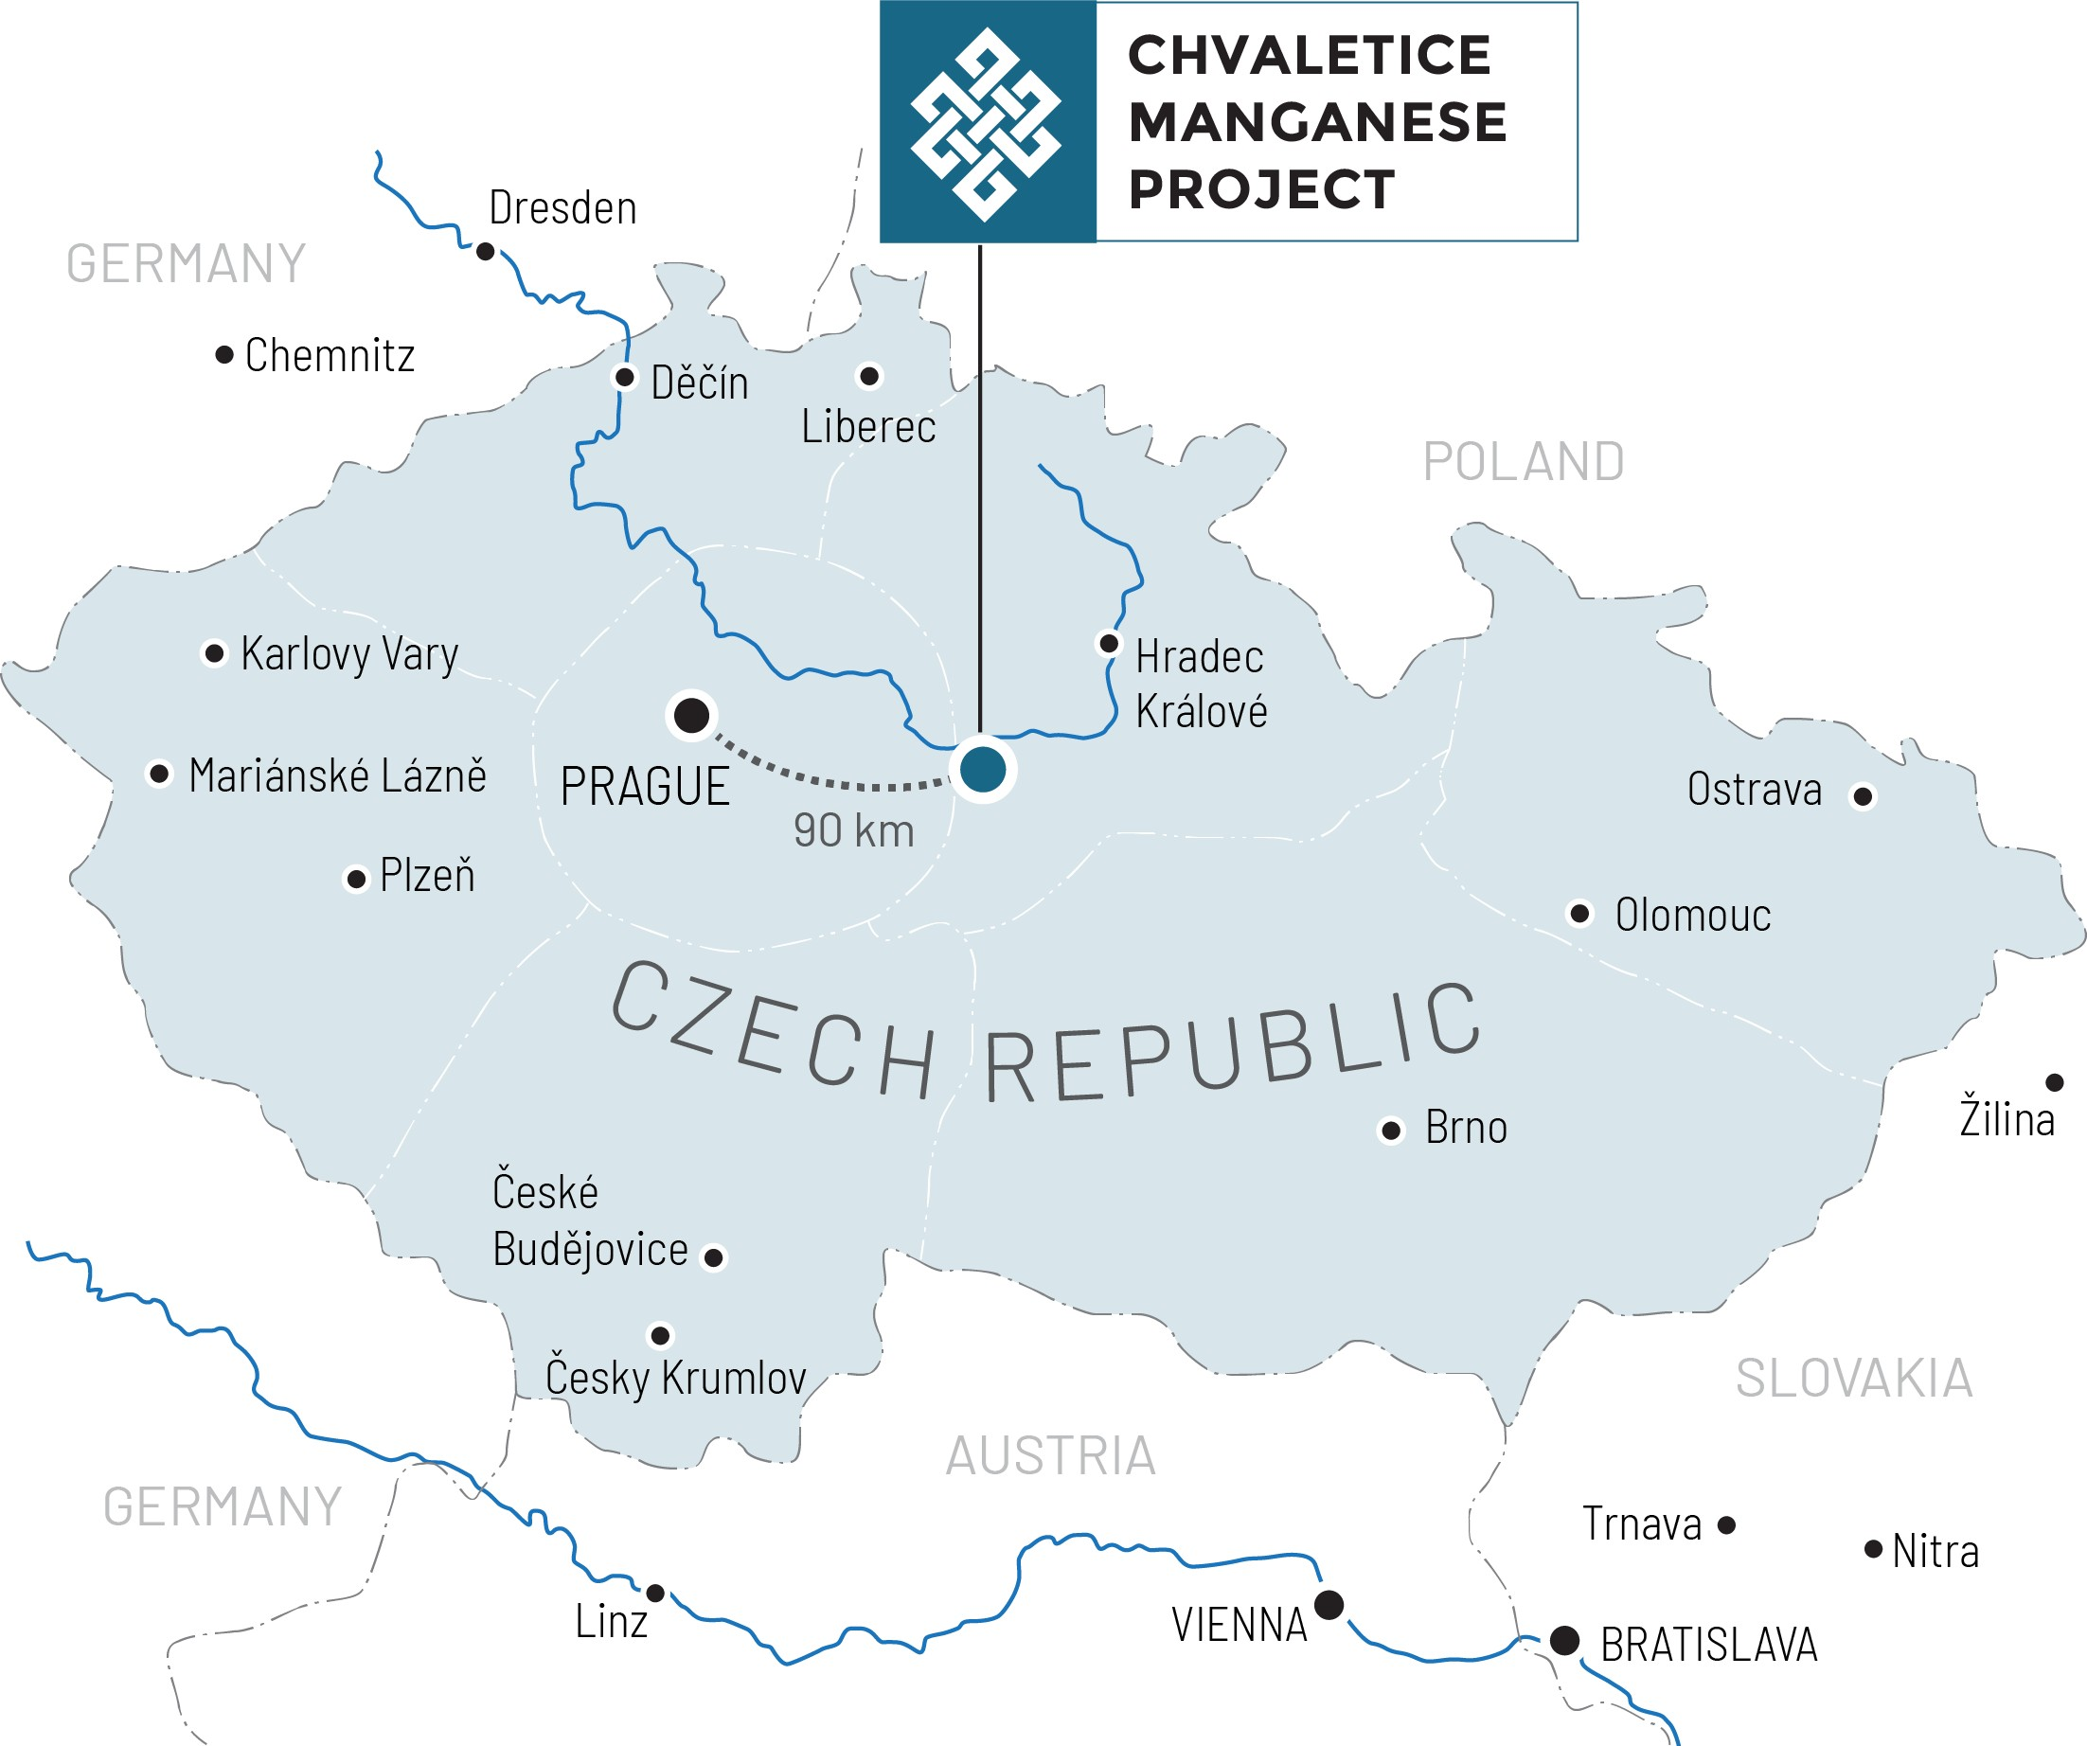
Czech Republic, within the European Union, is an excellent project location
PROJECT OVERVIEW
Politically stable and business-friendly jurisdiction in the European Union, with low corporate income tax rate of 19%
Surrounded by Europe’s automotive industry, which employs over 14 million people and is strongly committed to electrification
Excellent infrastructure of road, rail, and power
€7 billion from EU to support Czech Republic’s recovery and resilience plan, to address common European challenges by embracing the green and digital transitions

Slide 14
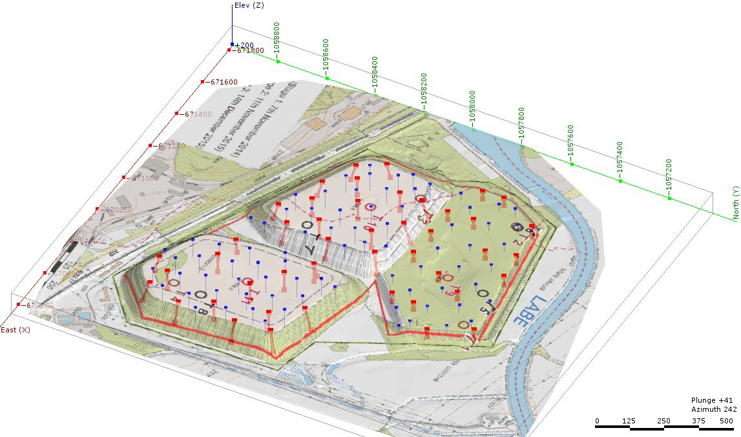
Resource is well defined and uniform
PROJECT OVERVIEW
98.3% of the Resource classified as Measured under NI 43:101/JORC 2012
Easily treated manganese carbonate* tailings – cost and environmental advantages
Resource model forms reliable basis for tailings extraction plan and shows uniform distribution of resource
Representative bulk samples collected with drill rig supported extensive 2018/2019 metallurgical test work and process design studies
Test mining program planned for 2022 in the context of Demonstration Plant development
Cell 1
Cell 3
Cell 2
2017-2018 Drill Program
2017 drill holes
2018 drill holes
* Clean carbonate ores, most suitable for HP Mn production, are rare. Oxide ores require extra treatment and removal of impurities is challenging

Slide 15
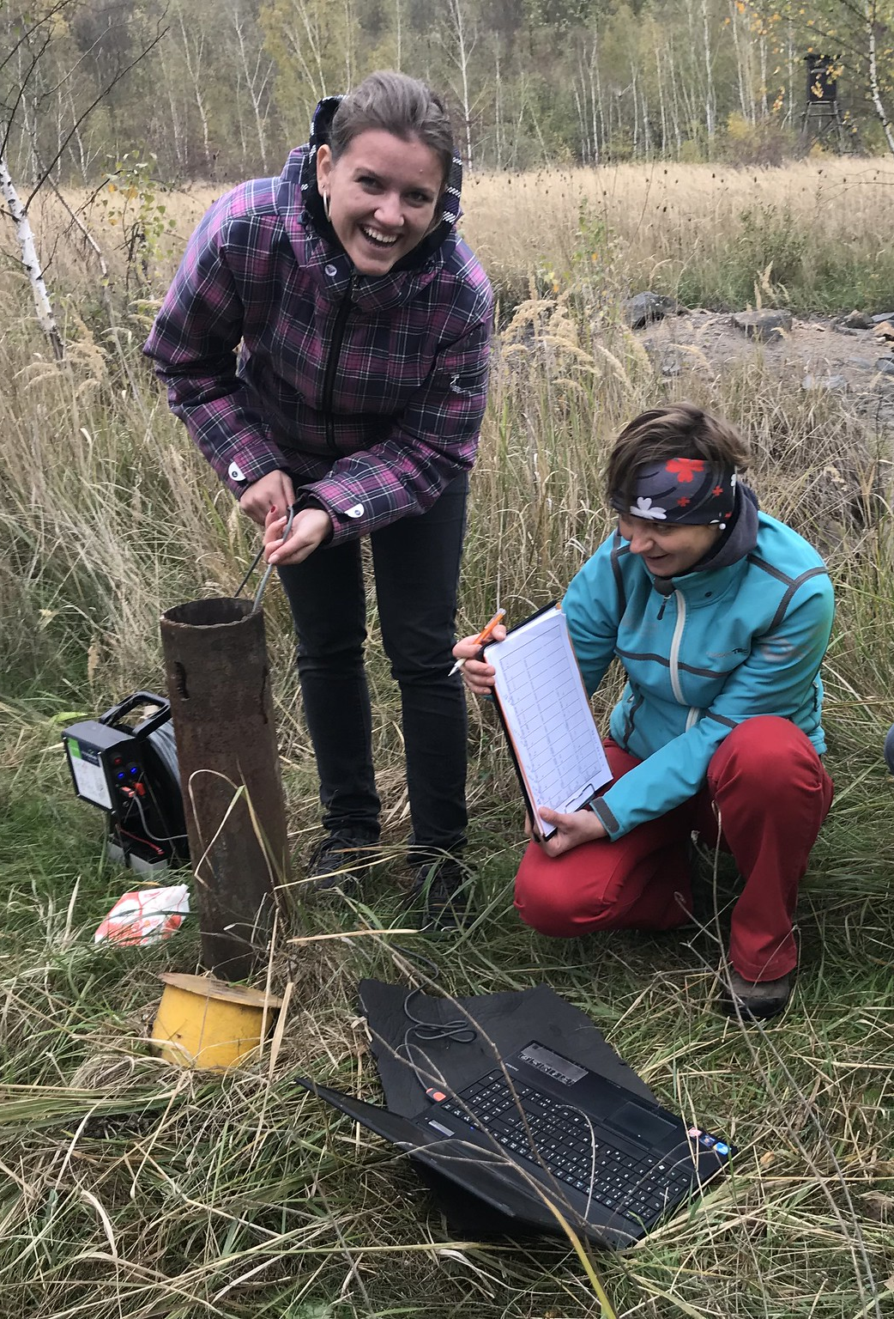
Aiming for best-in-class life-cycle performance
PROJECT OVERVIEW
Recovery of manganese by recycling waste tailings from a mine decommissioned in the 1970s
Remediation and rehabilitation of tailings, stopping environmental impacts from leaking salts and metals into the local water courses
Planning to use 100% renewable, CO₂-free power
Sourcing industrial water and steam from neighbouring power plant
Recycling of CO₂ and hydrogen process emissions, as well as reagent regeneration and recycling
Zero toxic selenium or fluorine used in process, unlike other manganese production
No CO₂ footprint from long-distance ore transportation : resource is adjacent to process plant

Slide 16
Target project timeline
PROJECT OVERVIEW
2022
2023
2024
2025
2026
1. DEMONSTRATION PLANT
Transport, Install & Commissioning
Customer samples & ongoing supply chain qualification
Available for testing other feedstocks
2. DEFINITIVE FEASIBILITY STUDY
3. ENGINEERING, PROCUREMENT, CONSTRUCTION, MANAGEMENT STRATEGY
Responses to RFQs and finalize study
Tender docs & bid process
Detailed engineering, construction, commissioning
4. PERMITTING PROCESS
Final EIA Report submission
EIA Public Review Period
Land planning permit & construction permit
Operational permits
5. FINANCING
Customer off-take contracts
Project Financing
Note: Timelines are subject to change based on the definitive feasibility study, permitting and EPC strategy outcomes

Slide 17
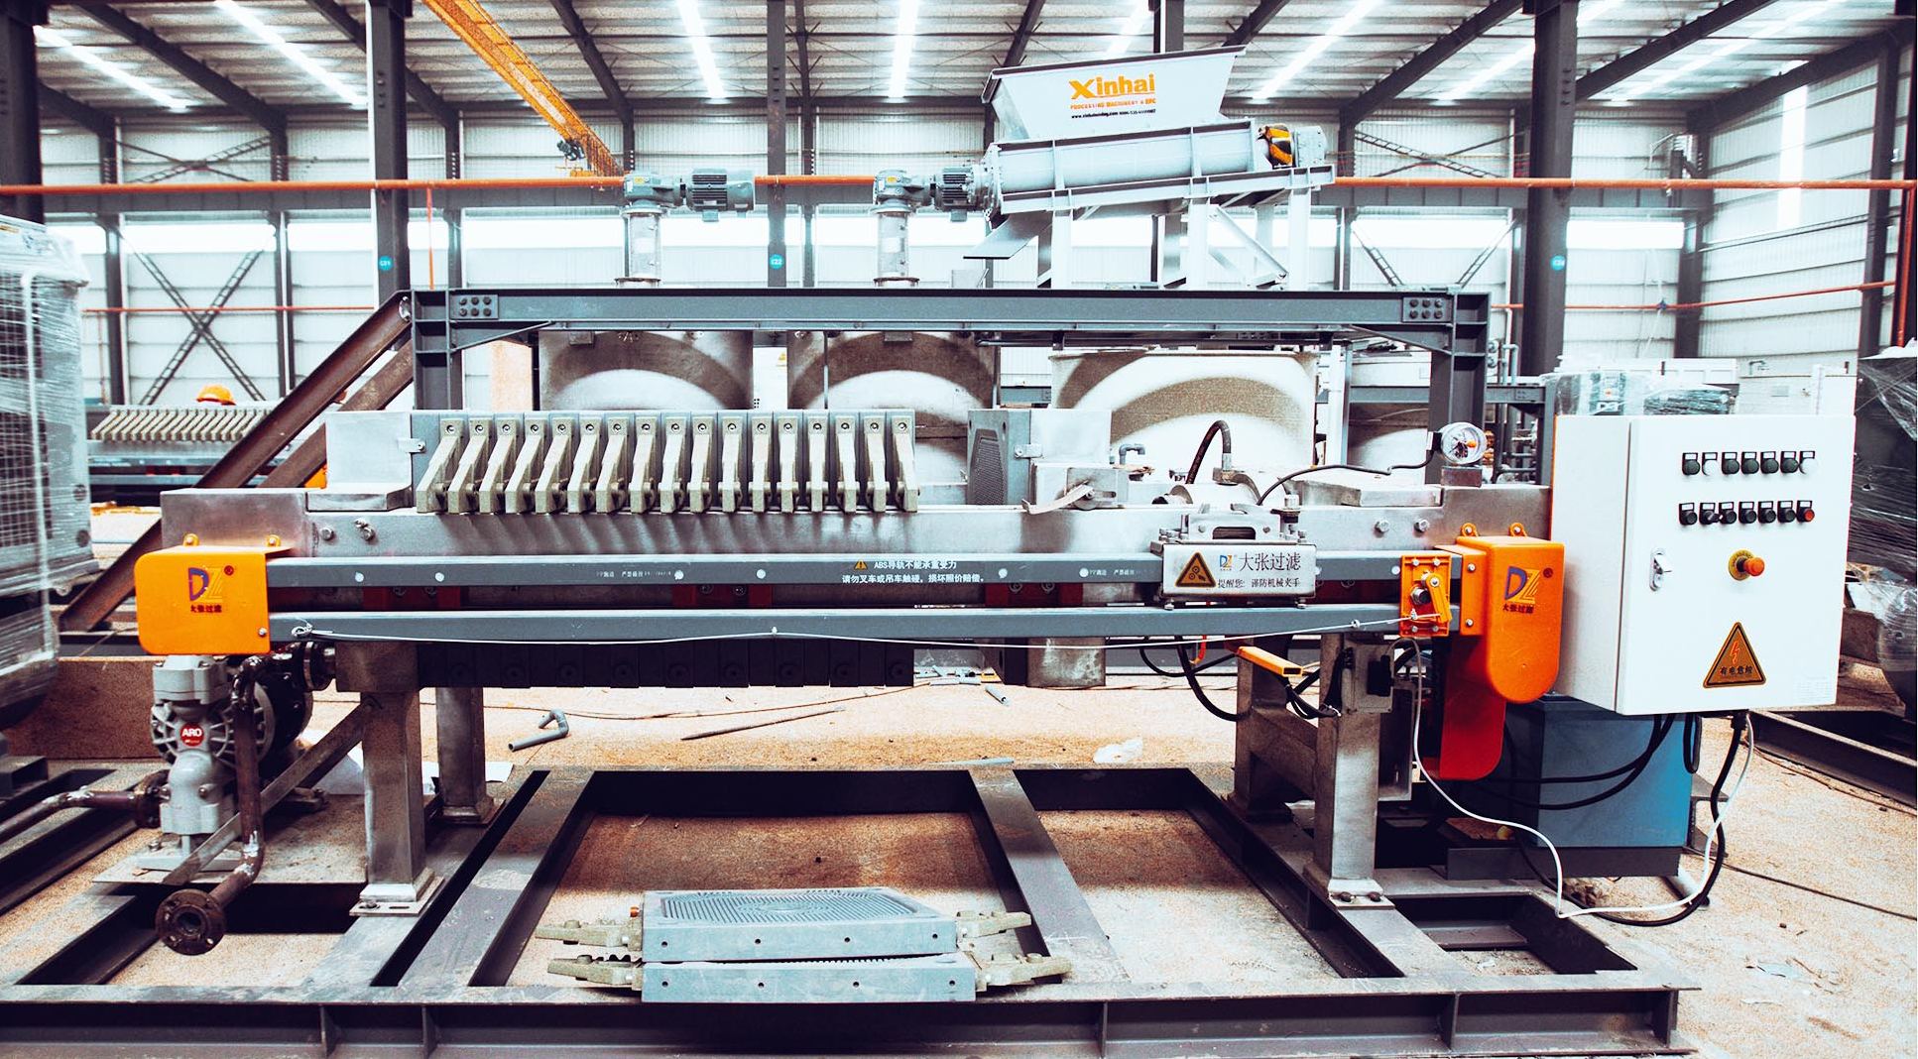
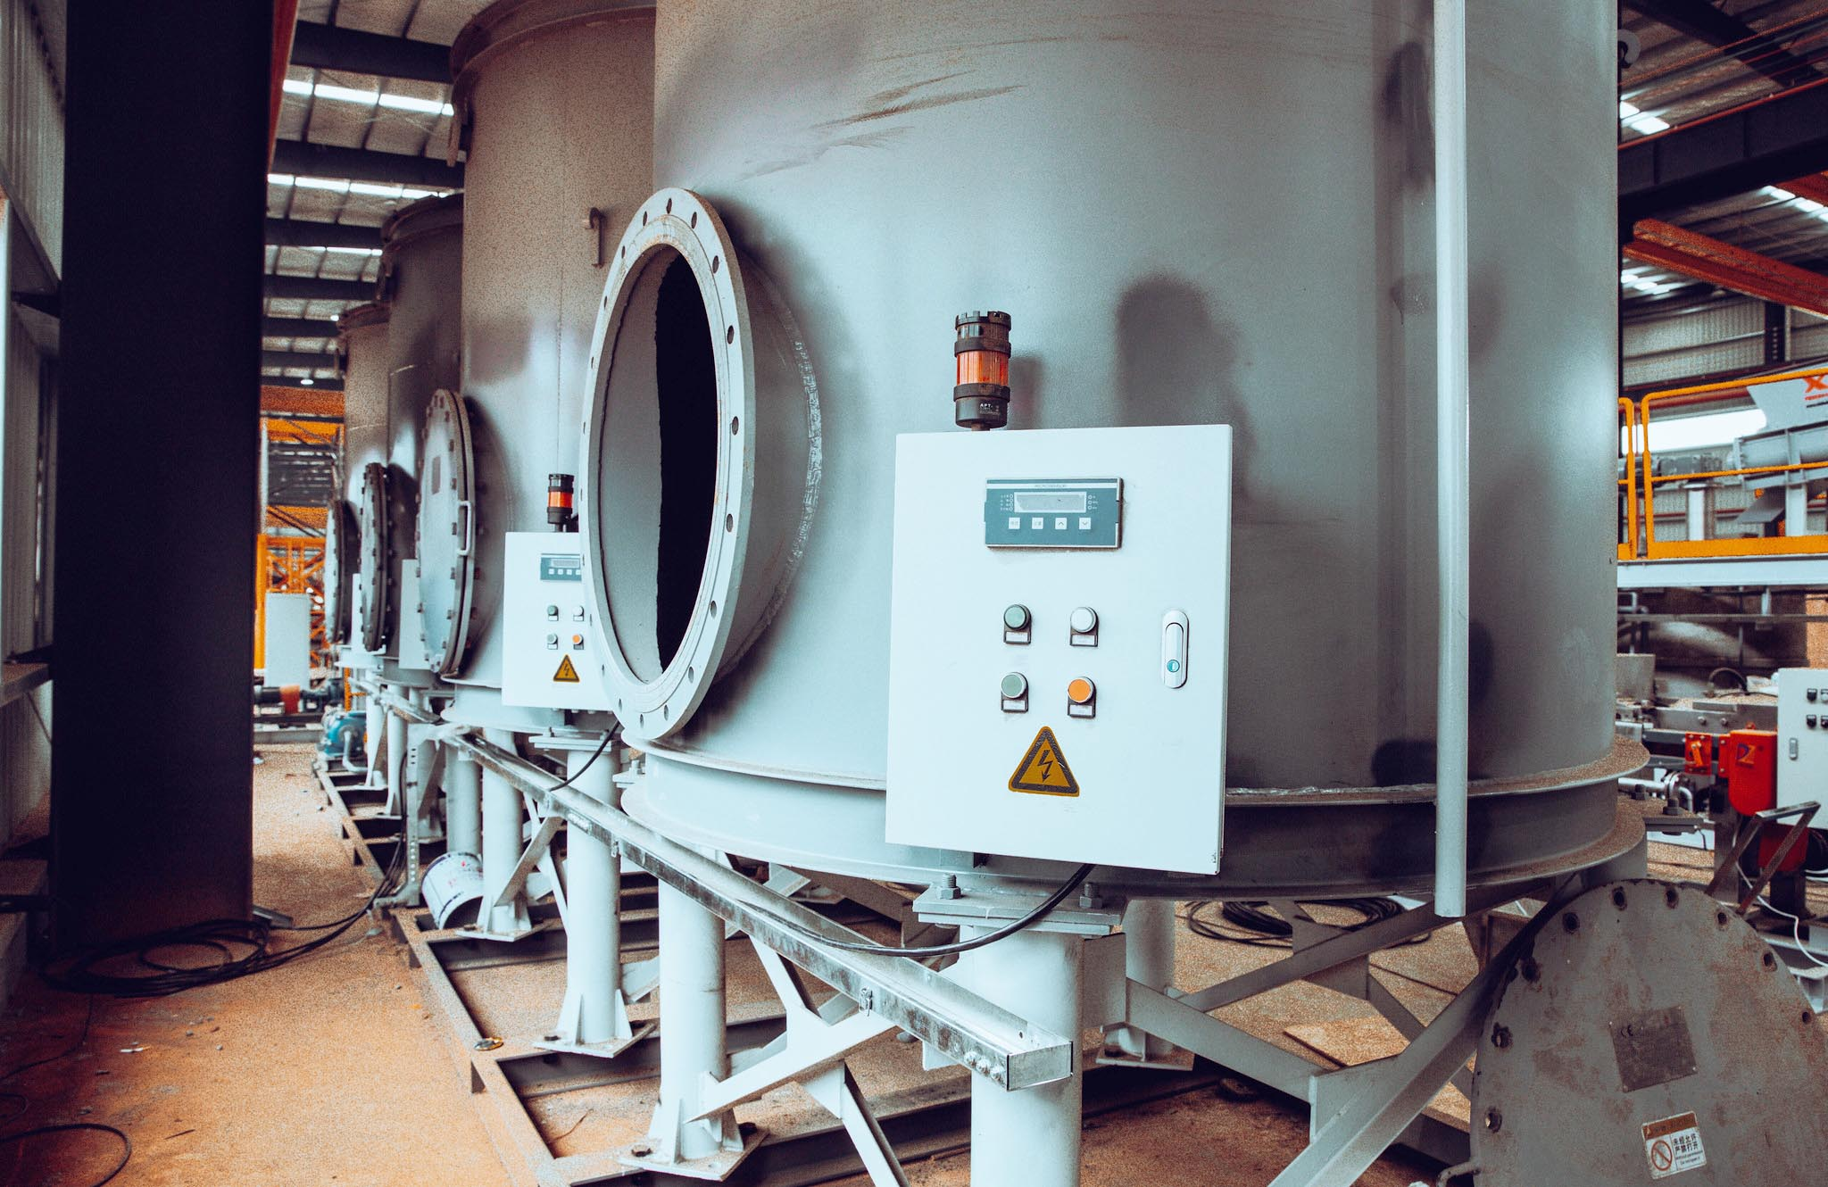
Demonstration plant is a key next step, with large sample production H2 2022
PROJECT OVERVIEW
Demonstration Plant is 7X scale-up of EMN’s successful Pilot Plant
Assembly and cold-commissioning completed, with final inspection and acceptance expected to be complete by March
Czech site delivery of Demonstration Plant modules targeted for April, with installation and commissioning scheduled for completion in August 2022
Demonstration Plant designed to produce large-scale product samples
Demonstration Plant is a key step on the path to supply chain qualification of Chvaletice high purity manganese products
55% of first year’s Demonstration Plant capacity has been allocated to five major international HPM customers (ongoing discussions and negotiations with other potential customers)
Filter press
Thickener units

Slide 18
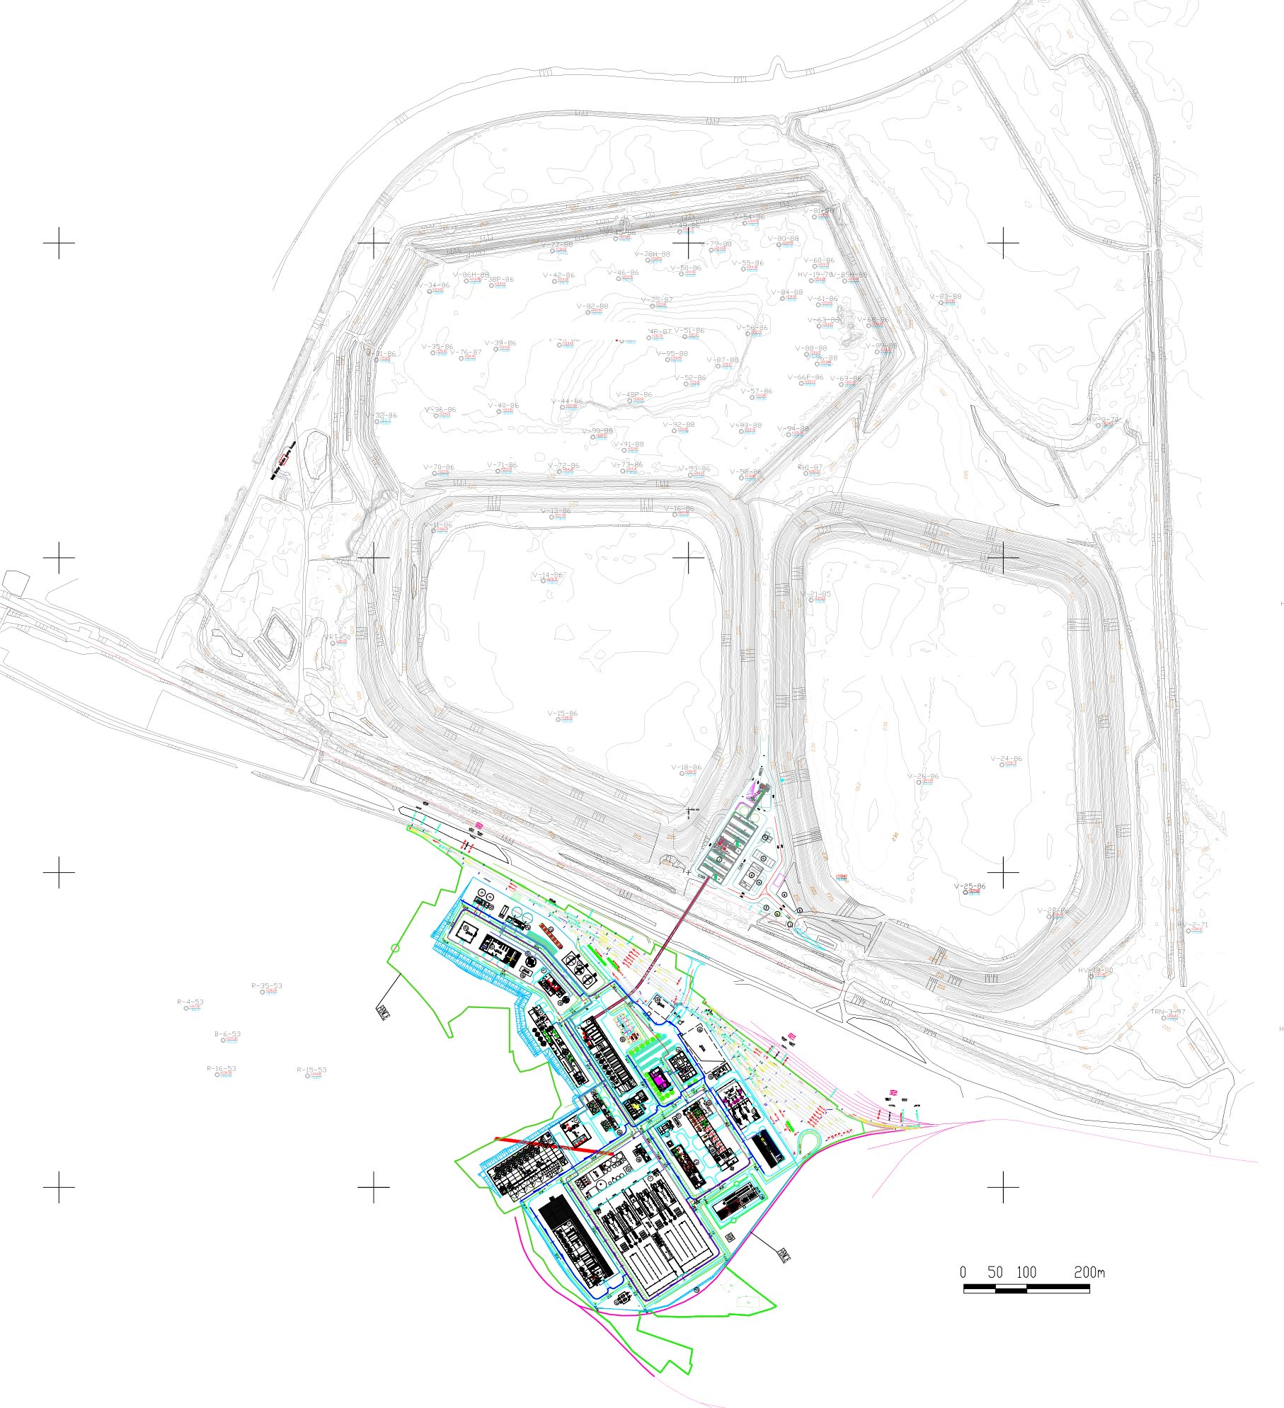
Feasibility study, approvals, and off-take discussions are progressing well
PROJECT OVERVIEW
Physical progress on feasibility study (FS) is more than 80% complete with final report expected in mid-2022
Tender and bid process well underway for power, reagents and equipment
Environmental and Social Impact Assessment (ESIA) filing targeted in 2022
Off-take discussions and negotiations continue with potential customers, including cathode, battery and automotive companies
Original pilot plant has been restarted to produce small product samples, helping to accelerate off-take supply-chain qualification
#3 ORE
STOCKPILE
#1 ORE
STOCKPILE
#2 ORE
STOCKPILE
PROCESSING PLANT

Slide 19




Strategic relationships to facilitate off-take and project financing
PROJECT OVERVIEW
Euro Manganese shareholders Facilitating offtake agreements with European customers Assisting with project funding from Europe-wide and regional grant programs, as well as European project finance and economic development banks | Working to facilitate the expansion/creation of European sources of raw materials Membership of 700 organizations New public-private Sustainable Battery Materials Fund set to invest ~ 400 million euros in 10 projects | Equity investment of CAD$8.5 million to support Chvaletice development Environmental, Social & Governance Policy is progressive and in keeping with international best practices EMN’s ESG standards were validated by a third-party due diligence review | Collaboration designed to develop applications of high-purity manganese in next-generation battery cathode active materials (CAM)

Slide 20
2019 PEA Key Metrics*
PROJECT OVERVIEW
Production Profile | 25-year project operating life producing 1.19 million tonnes of ultra-high-purity electrolytic manganese metal (“HPEMM”), two-thirds of which is expected to be converted into ultra-high purity manganese sulphate monohydrate powder (“HPMSM”)
Capex | US$404 million (+ US$24.8 million in sustaining capital, and US$31 million in working capital)
After-tax NPV | US$593 million, using a 10% discount rate
IRR | Ungeared, pre-tax 25.2% IRR with a 4.5-year payback Post-tax 22.6% IRR with a 4.9-year payback
EBITDA | Run rate EBITDA: average of US$197 million per annum on reaching full capacity Overall EBITDA margin: 55% Sensitivity of EBITDA to manganese price: +/- 10% → 59.5% / 50.5% EBITDA margin
* "Technical Report and Preliminary Economic Assessment for the Chvaletice Manganese Project, Chvaletice, Czech Republic" prepared by Tetra Tech, effective date: January 29, 2019; release date: March 15, 2019

Slide 21
Euro Manganese Inc. Capitalization
CAPITALIZATION AS AT FEBRUARY 10, 2022
Shares (including ~257.2 Mill. CDIs) | 401,115,551
Options | 35,120,998
Warrants | 8,500,000
Fully Diluted | 444,736,549
Ownership Structure at Feb. 10, 2022
Total 401,115,551
Directors, Founders &
Management
~47.7 M
11.9%
TRADING SYMBOLS
TSX-V and ASX: EMN OTCQX: EUMNF Frankfurt: E06 (12-month average volume of 1.2 million shares/day)
Others/unknown (Est.) ~171 M
42.6%
45.5%
Institutional (Est.)
~182.4 M
FINANCIAL METRICS
Cash balance – Dec. 31, 2021 | ~ CDN$29.1 million
Total Liabilities – Dec. 31, 2021 | ~ CDN$6.7 million
Debt | Zero debt
Market cap (Feb. 10, 2022 @ $0.45) | ~ CDN$180.5 million
Enterprise value (Feb. 10, 2021) | ~ CDN$155.4 million
12-month share price and volume – ASX
RESEARCH COVERAGE
Canaccord Genuity (Australia)
Note: C$8.5M EBRD investment closed on 10 February 2022

Slide 22

EMN in Summary
Largest manganese resource in Europe
To become Europe’s only primary producer of high-purity manganese products and a key component of the local battery supply chain
Exceptional quality, battery-grade products
Unique status as a waste-to-value recycling & rehabilitation project with local and global environmental benefits
Strong project support from local communities and governments
Project has support of EU-backed organizations EIT InnoEnergy and the European Bank for Reconstruction and Development
Well-funded and on-track for completion of all site and technical work required for a final investment decision in early 2023
ESG focus: Uncompromising standards

Slide 23
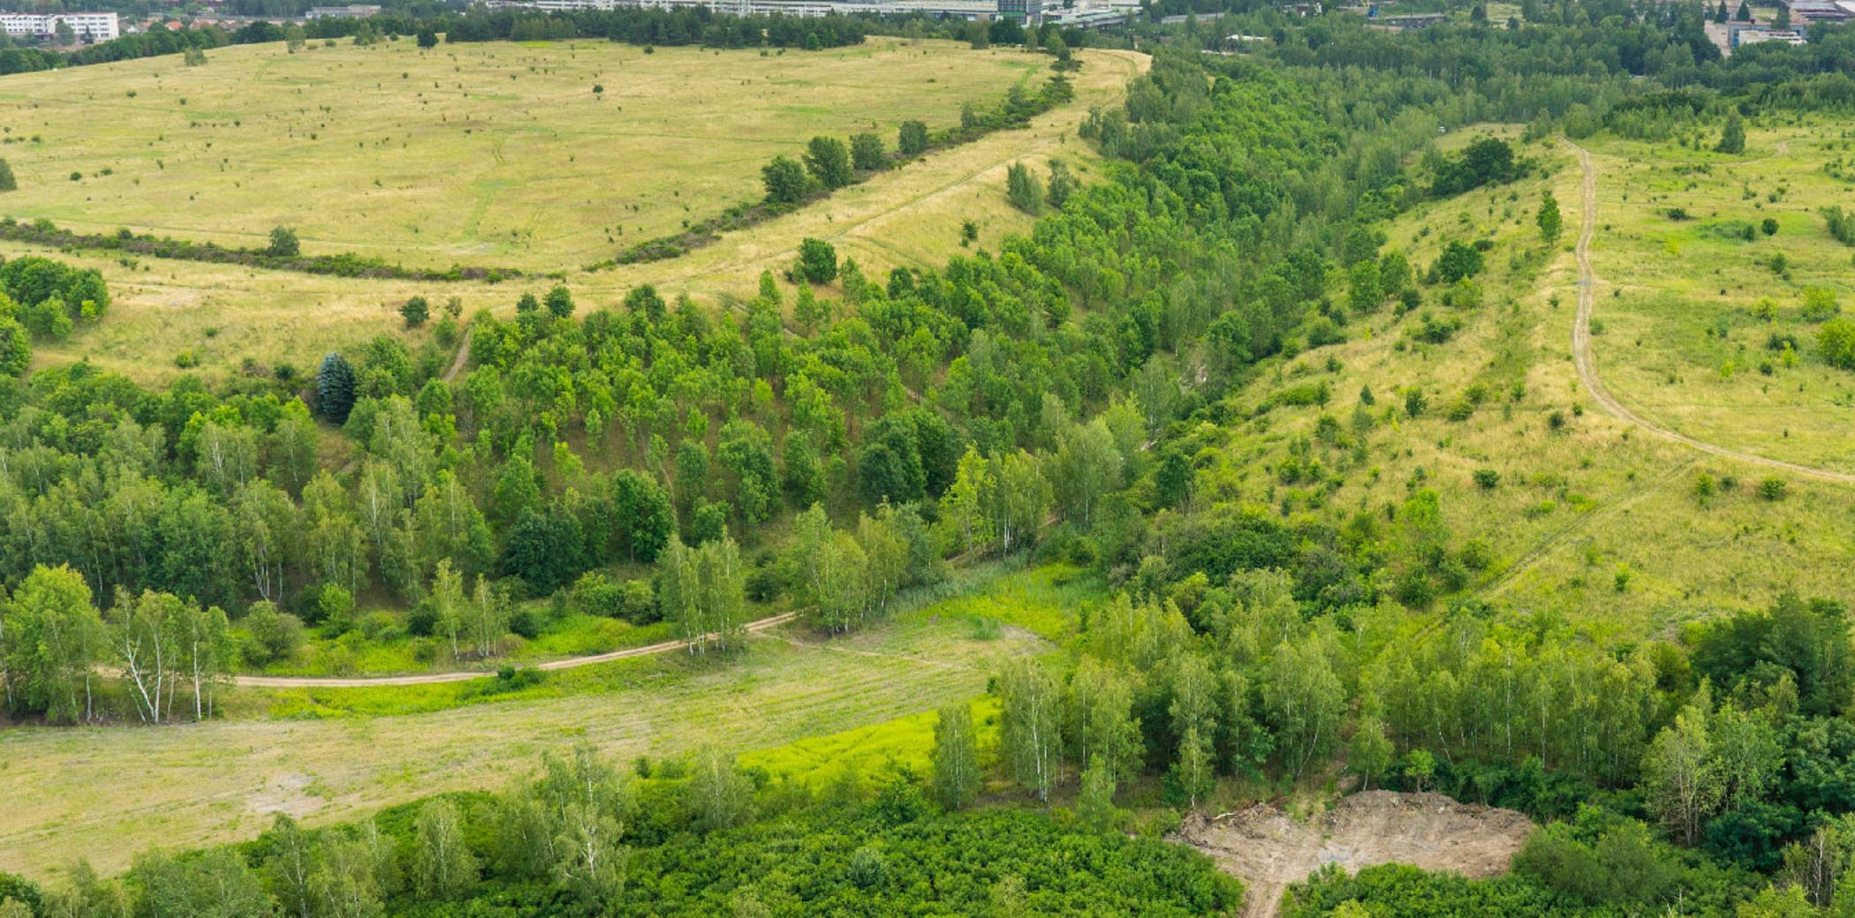
Matt James
President & CEO
604-681-1010
info@Mn25.ca
www.Mn25.ca
TSXV: EMN
ASX: EMN
OTCQX: EUMNF
Frankfurt Stock Exchange: E06

Slide 24
Q&A

Slide 25
Thank you!
Please visit our website at www.mn25.ca for more info
and add yourself to our mailing list
Email us at info@mn25.ca

Slide 26
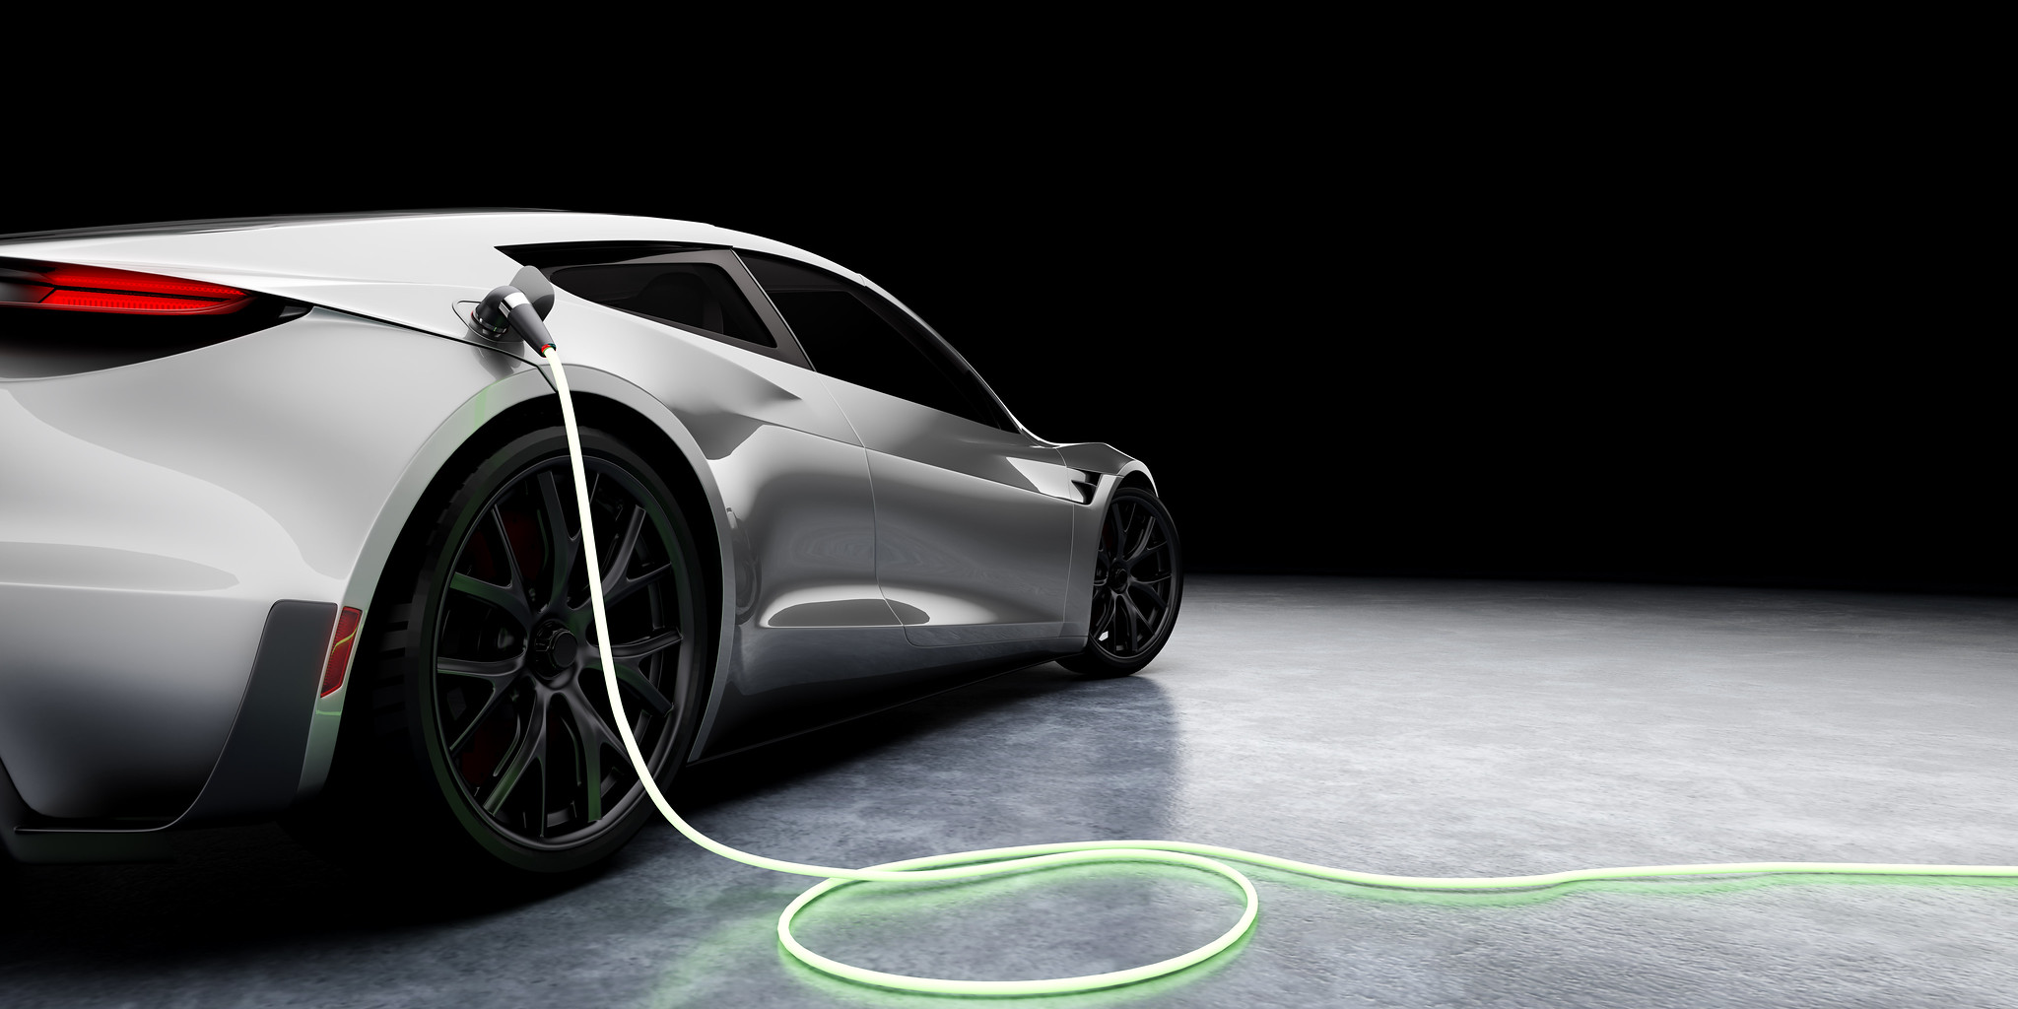
APPENDICES

Slide 27


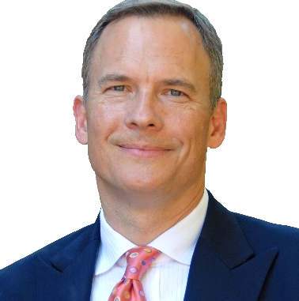
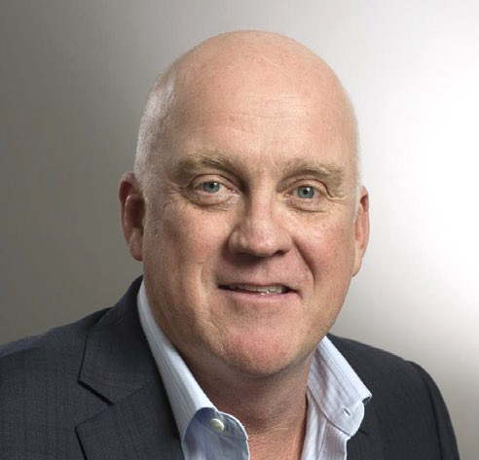
Independent directors
7
John Webster
CHAIRMAN & DIRECTOR
David Dreisinger
DIRECTOR
Tom Stepien
DIRECTOR
Gregory Martyr
DIRECTOR
Senior finance professional who spent over 30 years with PricewaterhouseCoopers until his retirement in 2014
Roles included British Columbia Managing Partner, three years as Assurance Leader in Romania and head of the firm’s mining practice in Canada
Extensive experience as audit partner and advising private and listed clients
Director of Eldorado Gold Corporation
Professor and Chair of the Industrial Research Chair in Hydrometallurgy at UBC
Published over 300 papers and inventor in 24 U.S. patents for work in hydro-metallurgical research
Active international consultancy for development of major hydrometallurgical projects and plants (Sepon (Laos), Mt. Gordon (Australia), Boleo (Mexico))
Current corporate roles as director and/or officer with Search Minerals, Polymet Mining, Cascadero Copper and Lead FX
Tom has over 30 years of hi-tech management, operations and engineering experience at small and large companies
Serves as Director of Primus Power Solutions, a battery energy storage company and was its CEO from 2009 to 2020; is currently CEO of QM Power, an innovative electric motor company
Prior to co-founding Primus, he was a VP at semiconductor equipment manufacturer Applied Materials
Holds a BS and MS in Mechanical Engineering from the Massachusetts Institute of Technology, is a co-inventor on numerous patents, and a frequent speaker at energy conferences
Brings an international entrepreneurial and technical perspective, having led diverse teams in several countries
Over 30 years of experience in resources investment banking and corporate finance, and international resource and mining company management, with a background of law and accounting
CEO of Battery Future Acquisition Corp. and Chairman of Capital Markets plc.
Former Managing Director with Standard Chartered Bank, ultimately as the Global Head of Advisory, Mining and Metals
Previously a partner with Gryphon Partners and held several executive roles with Normandy Mining Ltd.

Slide 28
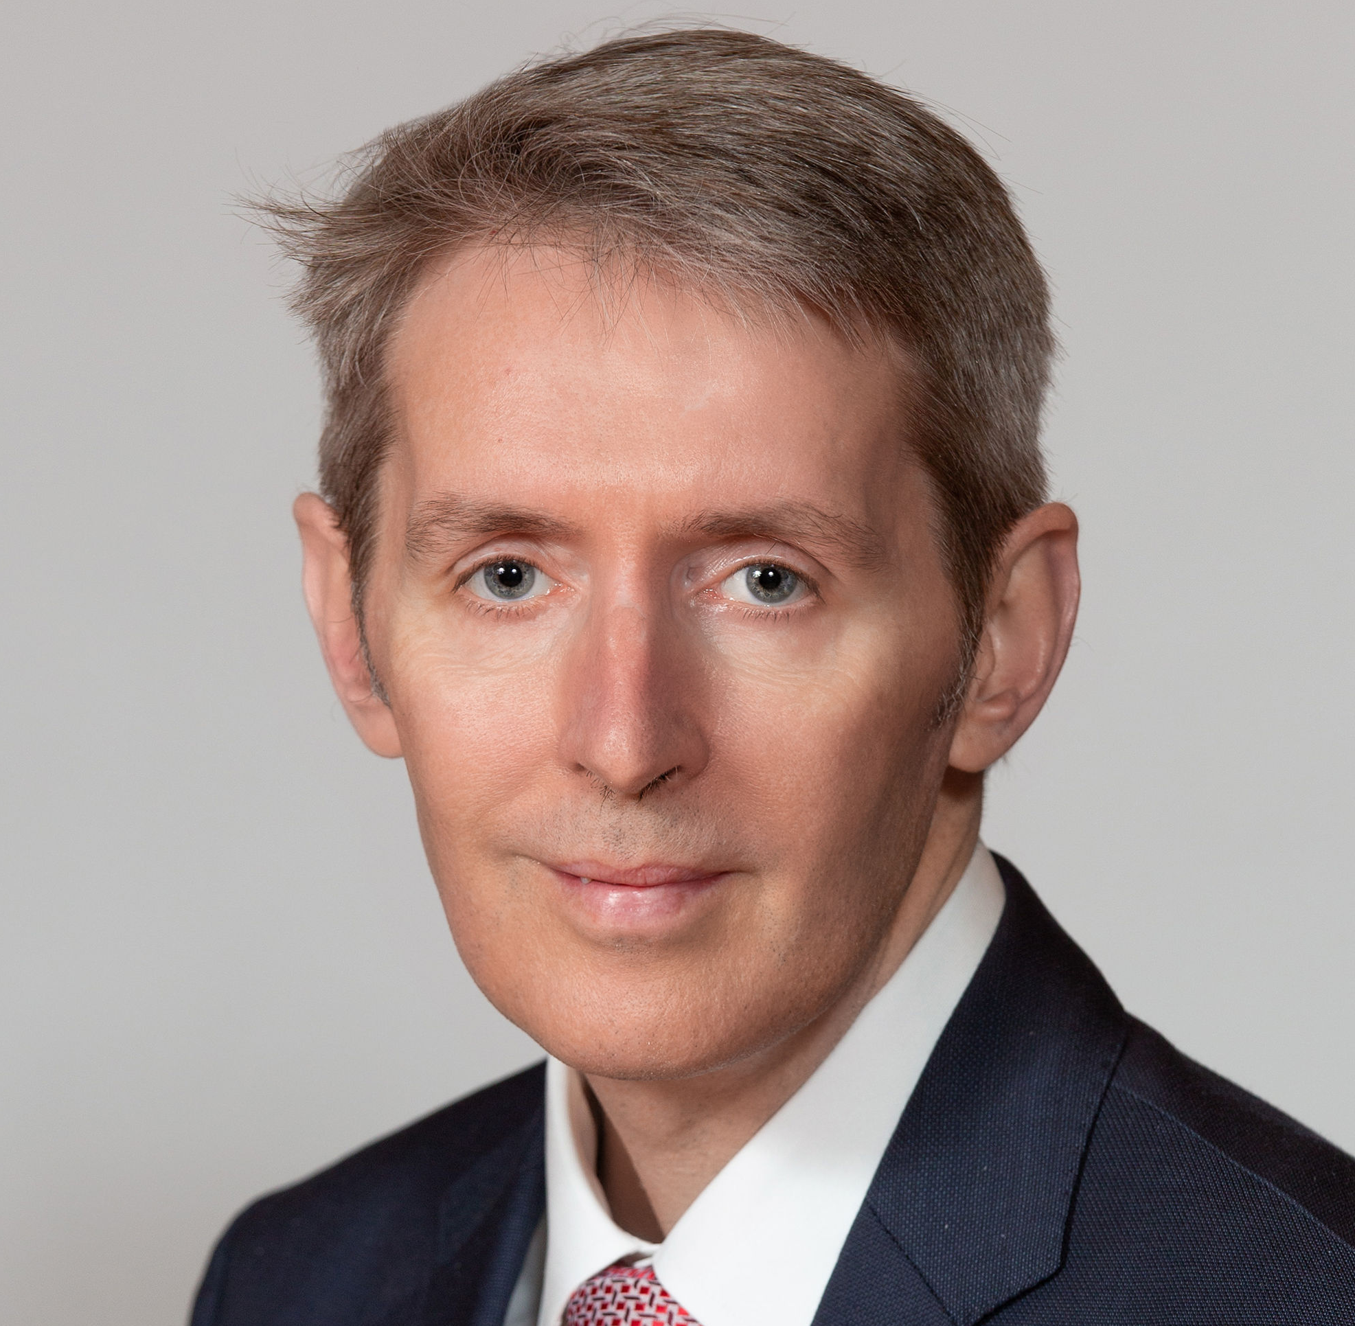
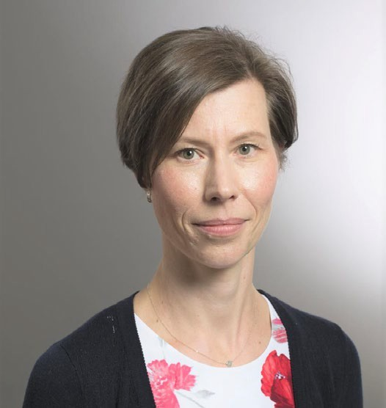

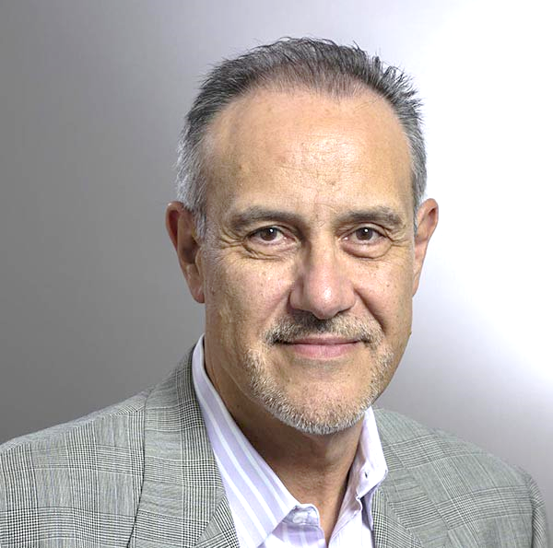
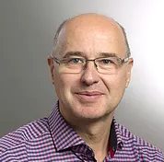
Executive leadership team
Matt James
PRESIDENT &
CHIEF EXECUTIVE OFFICER
Martina Blahova
CHIEF FINANCIAL OFFICER
Andrea Zaradic
VICE PRESIDENT OPERATIONS
Fausto Taddei
VP CORPORATE DEVELOPMENT & CORPORATE SECRETARY
Jan Votava
MANAGING DIRECTOR OF MANGAN CHVALETICE S.R.O
27 years of experience in a broad range of roles, including established industrials and small growth companies within the global natural resources industry
Previous senior roles: Engagement Manager at McKinsey & Co; Vice President, Strategy & Corporate Communications at Lynas Corporation, a specialty metals company; founding Managing Director of Rutila Resources; Vice President, Strategy and Business Development, Harsco Corporation
B. Eng. (Hons) degree in Ceramic Engineering from the University of New South Wales, Australia and a Ph.D. in Material Science and Engineering from Queens’ College at the University of Cambridge
Graduate member of the Australian Institute of Directors
20 years of experience in finance; including public practice with PricewaterhouseCoopers and Ernst & Young in the Czech Republic and UK
Previously corporate controller at Euro Manganese Inc.
Held senior roles in automotive and mining industry, including Manager of Financial Reporting at SSR Mining Inc. and FP&A manager for KS Kolbenschmidt Inc., a Czech subsidiary of the Rheinmetall Group AG
Qualified as a CPA, CGA (Canada) and as an ACCA (UK) and holds a Master’s Degree in International Business
30 years of experience in corporate, project and business development, focused on mining and renewable energy throughout the Americas, Africa, Asia and Europe
Held numerous senior roles including: President & CEO of Northair Silver; Program Manager for Ballard Power; VP Operations and Development for Magma Energy Corp.; Manager of Infrastructure Devel. for Canico Resource.; and Construction and Senior Process Oper. Eng. for BHP
Serves on the board of Kootenay Silver, and as Technical Advisor to Northleaf Capital
Holds a M.A.Sc degree in mechanical engineering and is a registered Professional Engineer in the Provinces of BC and Ontario
Over 35 years of public resource company experience with development and operating entities involved in precious and base metals, and metallurgical coal. Senior level experience in multiple mining operations, financing, treasury functions, off-take arrangements, tax planning and public company reporting and governance matters
Held Senior VP & CFO positions with Nevsun Resources Ltd., Aura Minerals Inc. and Western Canadian Coal Corp.
Qualified as a CPA (CA) in 1985
Engineer with 19 years experience as an executive leader in the Czech Republic
Responsible for leading Euro Manganese’s subsidiary in the Czech Republic, the company's organizational and reputational development, as well as project permitting and development
Previously held roles as Head of Transformation Team for Europe, Technical Director for Central Europe, and Executive Chairman and Managing Director for the Czech Republic for Lafarge Holcim
Holds a doctorate in mechanical engineering

Slide 29
2018 NI 43-101 / JORC Resource Estimate
Updated Resource Estimate NI 43:101/JORC 2012 Resource Estimate included in Technical Report dated March 15, 2019 by Tetra Tech Canada Inc.
2017 – 2018: 160-hole drilling program findings
    Manganese is for the most part evenly distributed through the entire tailings deposit
  Finely milled, unconsolidated tailings placed above ground expected to result in very low mining and virtually zero ore dressing costs
  ~80% of manganese is contained in easily leachable manganese carbonate minerals that require no calcination or chemical reduction prior to leaching, unlike manganese oxide ores
  98.3% of Chvaletice resource is now classified in Measured category
Chvaletice Mineral Resource Statement, Effective Date December 8, 2018*
Tailings Cell # | Classification | Volume (m³) | Tonnage (MT) | Dry In-situ Bulk Density (t/m³) | Total Mn (%) | Soluble Mn (%)
#1 | MEASURED | 6,577,000 | 10,029,000 | 1.52 | 7.95 | 6.49
 | INDICATED | 160,000 | 236,000 | 1.47 | 8.35 | 6.67
#2 | MEASURED | 7,990,000 | 12,201,000 | 1.53 | 6.79 | 5.42
 | INDICATED | 123,000 | 189,000 | 1.55 | 7.22 | 5.30
#3 | MEASURED | 2,942,000 | 4,265,000 | 1.45 | 7.35 | 5.63
 | INDICATED | 27,000 | 39,000 | 1.45 | 7.90 | 5.89
TOTAL | MEASURED | 17,509,000 | 26,496,000 | 1.51 | 7.32 | 5.86
 | INDICATED | 309,000 | 464,000 | 1.50 | 7.85 | 6.05
COMBINED | M&I | 17,818,000 | 26,960,000 | 1.51 | 7.33 | 5.86
* Resources are not to be considered reserves and their economic viability has not been proven or confirmed.

Slide 30
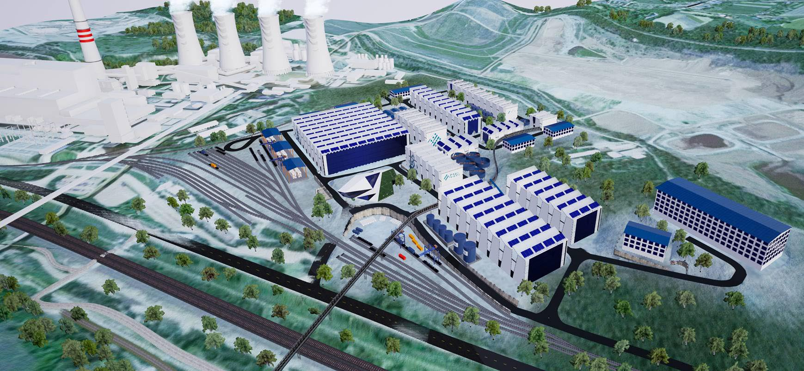
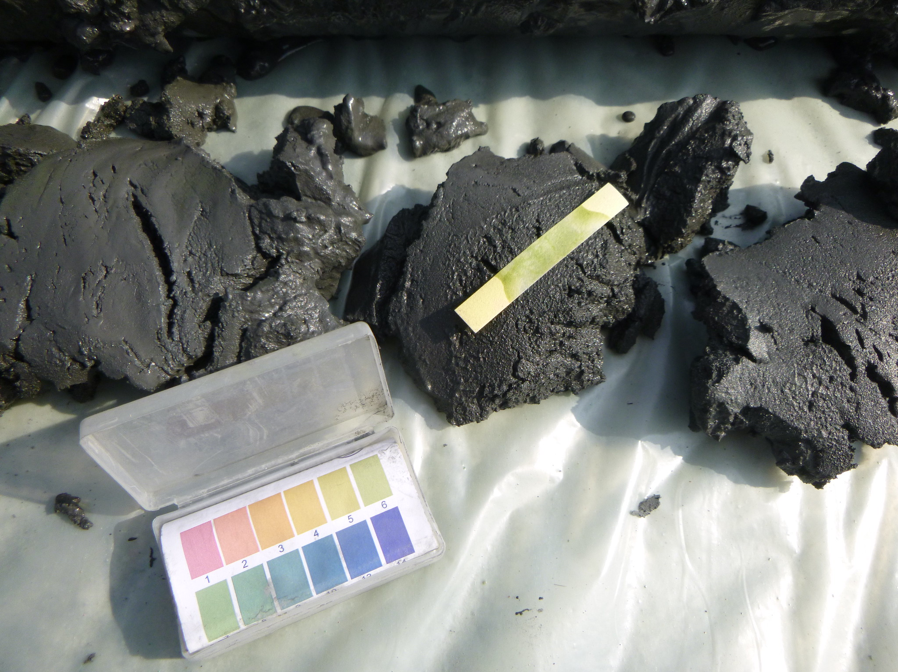
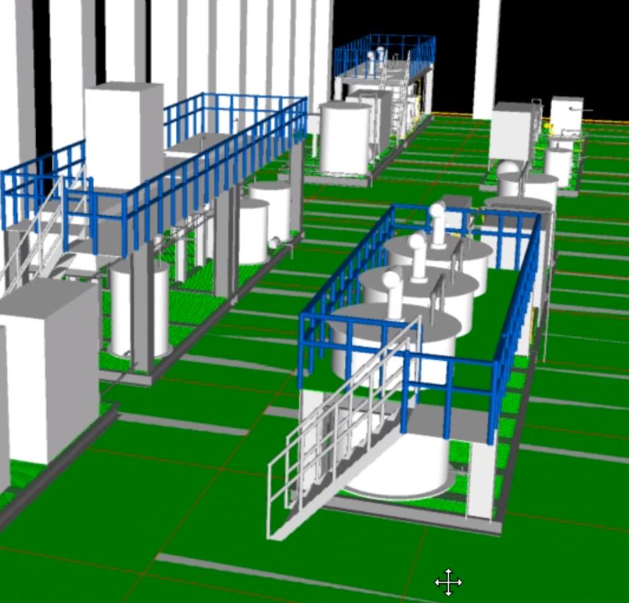
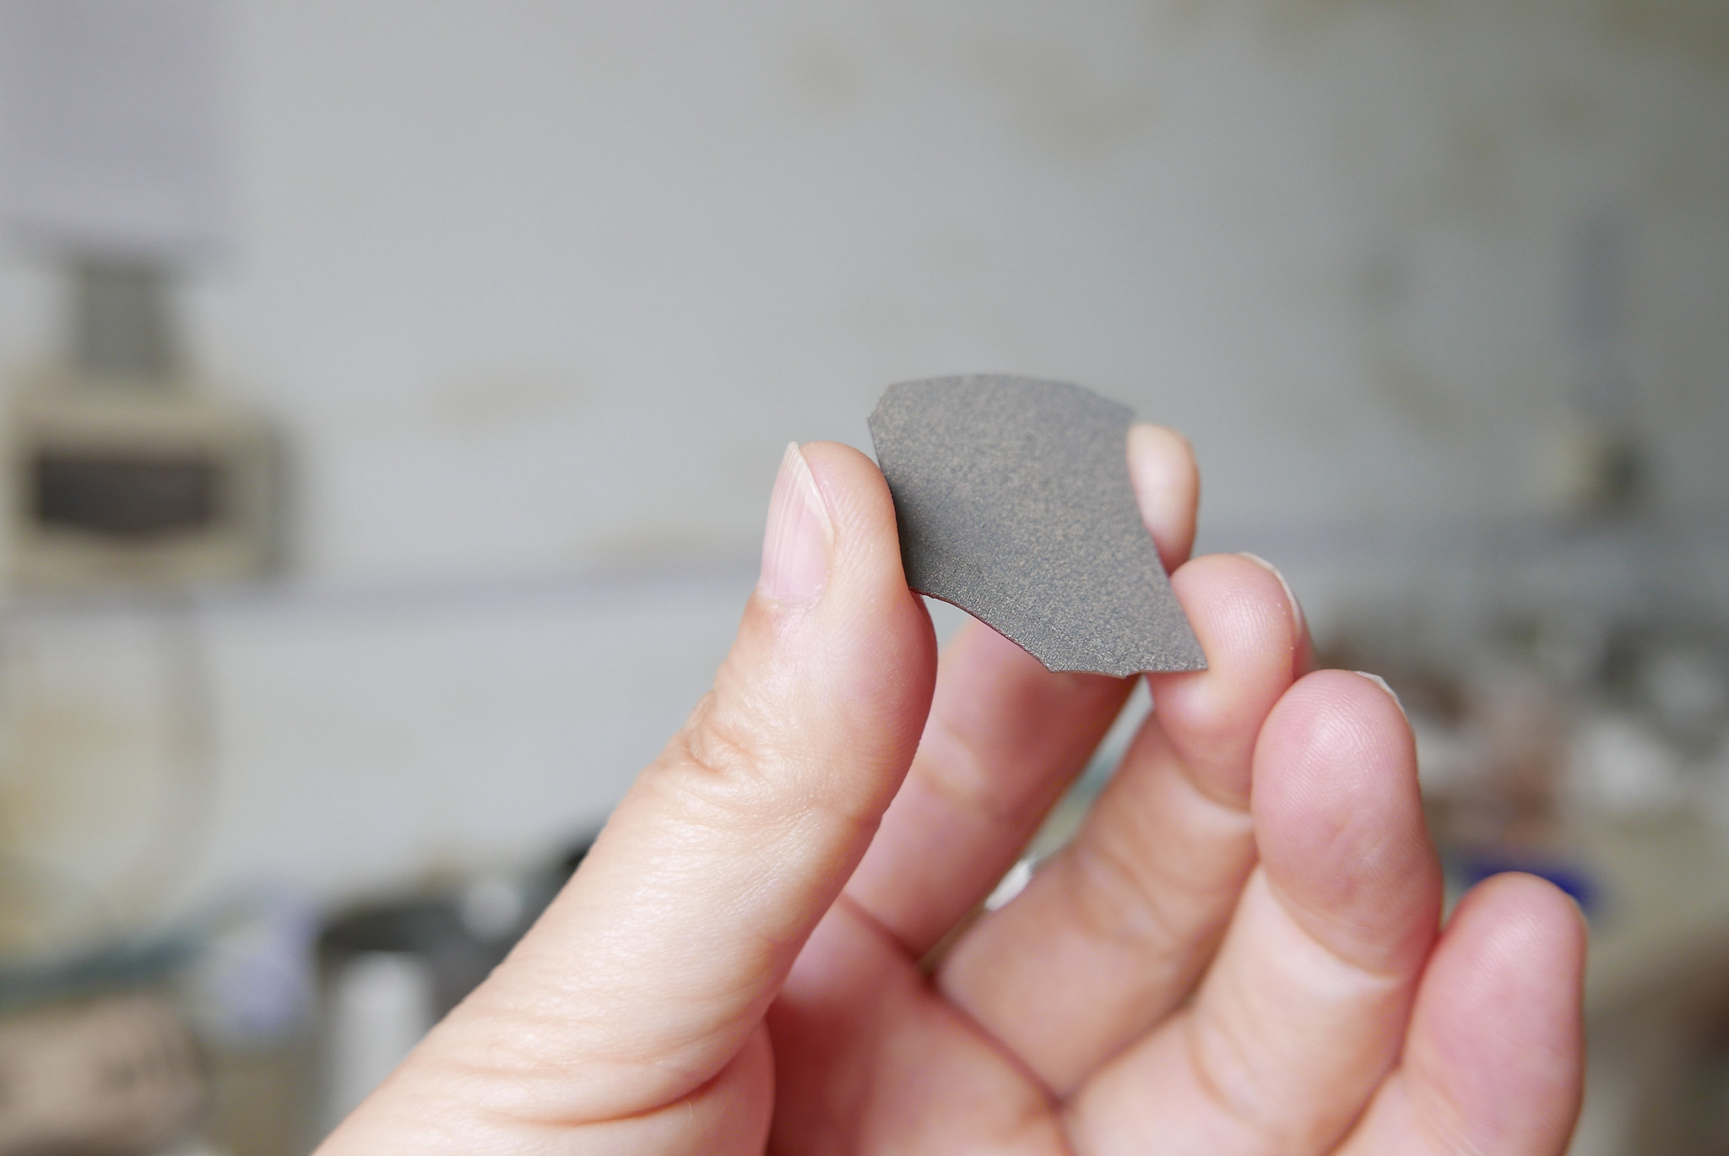
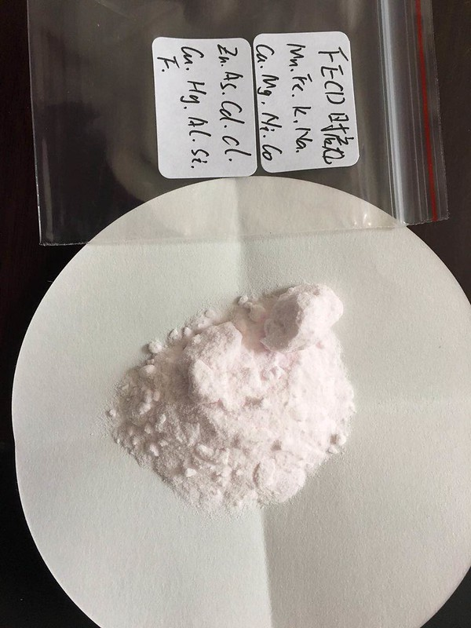
Robust process flow sheet
Using proven, conventional and commercial technologies
High quality product assurance, flexible, efficient and clean
Raw tailings
excavated and fed
into plant
Magnetic
separation
Leaching and
purification
Electrolysis = HPEMM flakes
HPEMM dissolution, deep purification & crystallization = HPMSM powder
Opportunities for additional value-added products

Slide 31
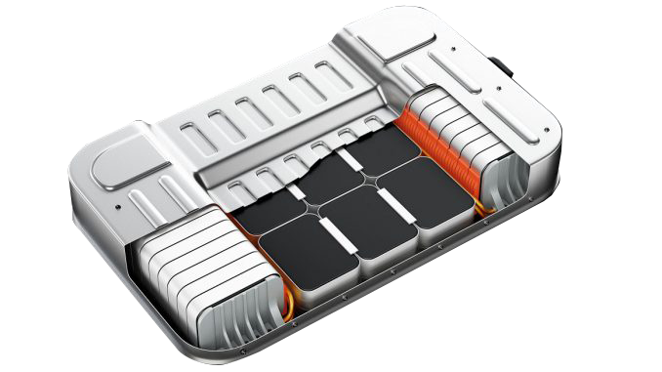
Project Focused on Two Manganese Products
High-Purity Manganese (HPM)
Not a commodity – a highly specialized product
Unlike the manganese ore that is used to make steel and aluminium alloys, agricultural soil supplements, food supplements, pigments, batteries and more
Challenging to produce battery-grade HPM sustainably
High-purity manganese
sulphate Monohydrate
(HPMSM >99.9% purity)
High-purity electrolytic
manganese metal
(HPEMM >99.9% purity)
The manganese product used by most lithium-ion battery makers
Will account for approximately 2/3 of Chvaletice production
Used by some precursor producers who prefer to make their own manganese sulphate solution
Will account for approximately 1/3 of Chvaletice production
Additional, bespoke products under evaluation

Slide 32





















At the heart of Europe’s green transition
FINLAND ~15 GWh
GREECE 1 GWh
GERMANY 40 GWh
FINLAND
FRANCE 24 GWh
GERMANY 40 GWh
Europe is becoming a global hub for EV and battery production
FINLAND
FRANCE 0.5 GWh
GERMANY 24 GWh
CHVALETICE
MANGANESE
PROJECT
FINLAND
FRANCE 24 GWh
ITALY 24 GWh
GERMANY
FRANCE 2 GWh
ITALY 70 GWh
POLAND ~30 GWh
FRANCE 50 GWh
ITALY 2.5 GWh
HUNGARY
GERMANY 5 GWh
SERBIA
GERMANY 0.8 GWh
SLOVAKIA 10 GWh
Precursors & Cathodes
SWEDEN 40 GWh
GERMANY 24 GWh
SWEDEN 3 GWh
GERMANY 2 GWh
SPAIN 3 GWh
Battery Cells
SWEDEN 40 GWh
GERMANY 34 GWh
SWITZERLAND 10 GWh
Battery Parts
(Separator, Electrolyte)
SWEDEN 40 GWh
GERMANY 100 GWh
SWITZERLAND 1 GWh
Battery Packs
NORWAY 20 GWh
GERMANY 1 GWh
TURKEY 50 GWh
NORWAY 40 GWh
GERMANY 16 GWh
Electric Car Factory
NORWAY 32 GWh
GERMANY 2.3 GWh
POLAND
NORWAY 5 GWh
GERMANY 0.3 GWh
POLAND
UNITED KINGDOM 35 GWh
GERMANY 1 GWh
UNITED KINGDOM 5 GWh
POLAND
UNITED KINGDOM 2.5 GWh
GERMANY 30 GWh
HUNGARY
UNITED KINGDOM 35 GWh
GERMANY 1 GWh
POLAND 70 GWh
GERMANY 12 GWh
POLAND
POLAND 40 GWh
GERMANY 20 GWh
Daimler
POLAND
HUNGARY 7.5 GWh
GERMANY 24 GWh
AUSTRIA
HUNGARY 16 GWh
GERMANY 250 GWh
Jaguar
UNITED KINGDOM
HUNGARY 30 GWh
GERMANY 10 GWh
UNITED KINGDOM
HUNGARY 20 GWh
CZECH REP 20 GWh
SPAIN
HUNGARY 7.5 GWh
SPAIN
Vertically integrated precursor/cathode and cell production
Source: Cairn Energy Research Advisors and CPM Group ©2022

Slide 33
Compliance Statements
Competent and Qualified Persons Statement
All production targets for the Chvaletice Manganese Project referred to in this presentation are underpinned by estimated Measured and Indicated Mineral Resources prepared by competent persons and qualified persons in accordance with the requirements of the Joint Ore Reserves Committee Australasian Code for Reporting of Exploration Results, Mineral Resources and Ore Reserves 2012 Edition (“JORC Code”) and National Instrument 43-101 - Standards and Disclosures for Mineral Projects (“NI 43‐101”), respectively. Additionally, the scientific and technical information included in this presentation is based upon technical reports prepared by Mr. James Barr, P. Geo, Senior Geologist, Mr. Jianhui (John) Huang, Ph.D., P. Eng., Senior Metallurgical Engineer, Mr. Hassan Ghaffari, P.Eng, M.A.Sc., Senior Process Engineer, Mr. Chris Johns, P.Eng., and Mr. Mark Horan, P.Eng, MSc., Senior Mining Engineer, all with Tetra Tech Canada Inc. (“Tetra Tech”), and entitled “Technical Report and Preliminary Economic Assessment for the Chvaletice Manganese Project, Chvaletice, Czech Republic” having an effective date of 29 January 2019 (release date 15 March 2019) (the “NI-43-101 Technical Report”) and “Public Report and Preliminary Economic Assessment for the Chvaletice Manganese Project, Chvaletice, Czech Republic” having an effective date of 29 January (release date 22 March 2019) (the “JORC Code Report”). The NI-43-101 Technical Report was filed on SEDAR at www.sedar.com on 15 March 2019 and the JORC Code Report was lodged with the ASX on 26 March 2019. The above-named persons are consultants to, and independent of the Company within the meaning of NI 43-101, and have sufficient experience in the field of activity being reported to qualify as Competent Persons as defined in the JORC Code, and are Qualified Persons, as defined in NI 43-101. Messrs. Barr, Huang, Ghaffari, Johns, and Horan have no economic or financial interest in the Company and consent to the inclusion in this presentation of the matters based on their information in the form and context in which it appears.
References to ASX and TSX-V Market Announcements
This presentation contains information extracted from certain of the Company’s ASX and TSX-V market announcements, as shown below, including exploration results, estimates of Measured and Indicated Mineral Resources, and production targets as reported in accordance with the JORC Code and NI 43‐101 standards:
The summary of results from the Preliminary Economic Assessment reported on page 19 of this presentation were reported in the TSX-V and ASX market announcement dated 30 January 2019.
The decision made to proceed to Feasibility Study stage reported on pages 15 and 17 of this presentation was reported in the TSX-V and ASX market announcement dated 22 May 2019.
Results of the drilling program and metallurgical testing reported on pages 13 and 26 of this presentation were reported in TSX-V and ASX market announcements dated 17 October 2018 and 17 December 2018.
The simplified process flowsheet reported on page 27 of this presentation was reported in the TSX-V and ASX market announcement dated 30 January 2019.
Production details related to the proposed demonstration plant reported on pages 16 of this presentation were reported in the TSX-V and ASX market announcement dated 12 December 2019.
Information about EIT InnoEnergy’s support of the Chvaletice Manganese Project on page 3, 18 and 21 of this presentation was reported in TSX-V and ASX market announcement dated 22 February 2021.
Information about the restart of the pilot plant referred to on pages 17 of this presentation was reported in TSX-V and ASX market announcement dated 14 June 2021.
Information about a joint development agreement between Euro Manganese and Nano One referred to on page 18 of this presentation was reported in a TSX-V and ASX market announcement dated 4 October 2021.
Information about the European Bank for Reconstruction and Development’s investment in Euro Manganese referred to on pages 18 and 21 of this presentation was reported in a TSX-V and ASX market announcement dated 4 January 2022.
The Company is not aware of any new information or data that materially affects the information contained in the above-referenced market announcements. The Company also confirms that all material assumptions and technical parameters underpinning the estimates of Measured and Indicated Mineral Resources as provided in the relevant market announcements, as well as all material assumptions underpinning the production targets and financial forecast information in the JORC Code Report, continue to apply and have not materially changed, and that the form and context in which the Competent Persons’ findings are presented have not been materially modified.

